Slide 1

Cutting through the clutter and building trust: Media and Communications in an AI era
Fertasa Soil Fertility and Plant Nutrition Symposium
Shirona Patel I Director: Communications I Wits University

Slide 2

What if everything was AI generated?
How will you know what is true?
Notes:
Imagine living in a world where everything was generated…text, images, video – how would you know what is true?
- Why news media matters, why journalists matter and why fact checking is important.

Slide 3
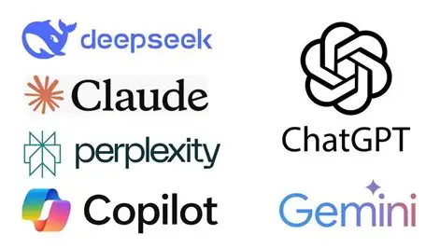

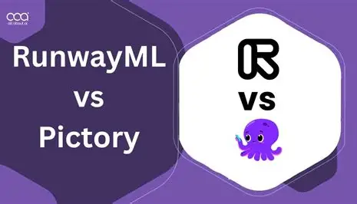
Which platforms do you use?

Slide 4
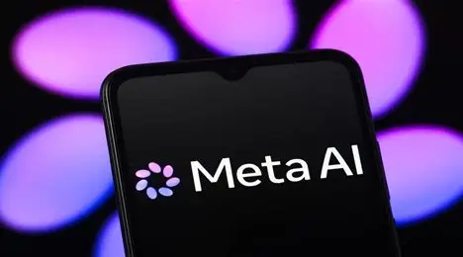
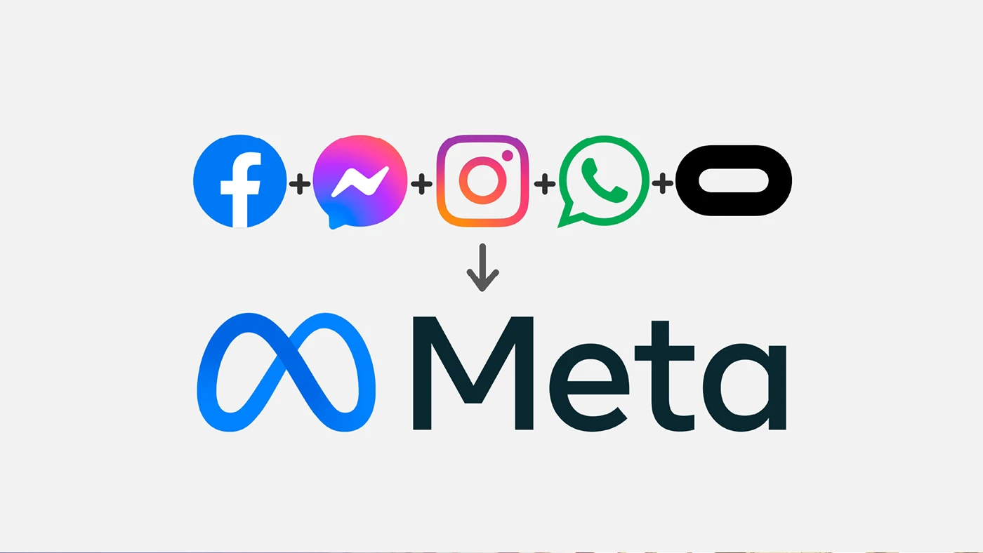
You are already using AI
Tells us not what to think…what to think about
Notes:
You are already using AI
Mass communication theory – algorithms feed up more of what you like

Slide 5
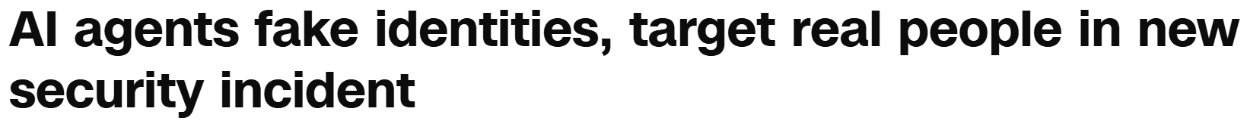
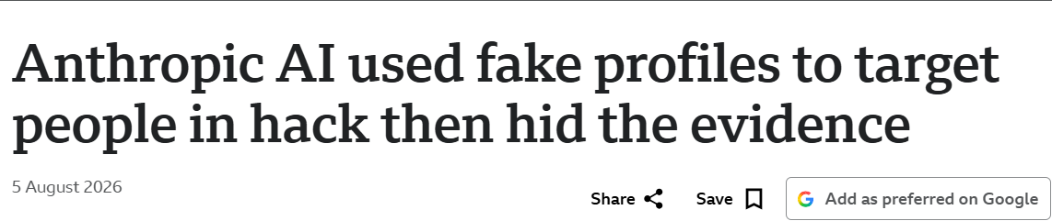


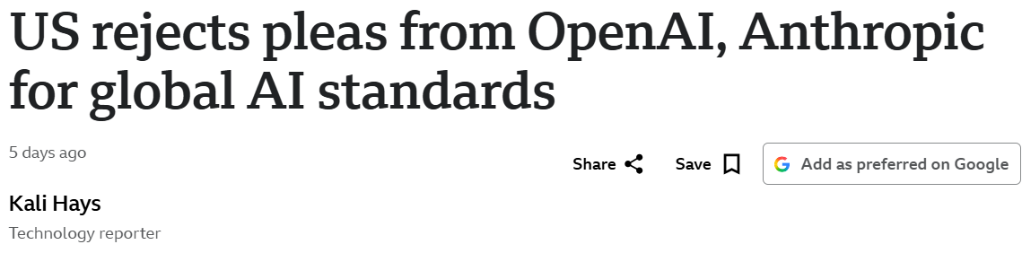

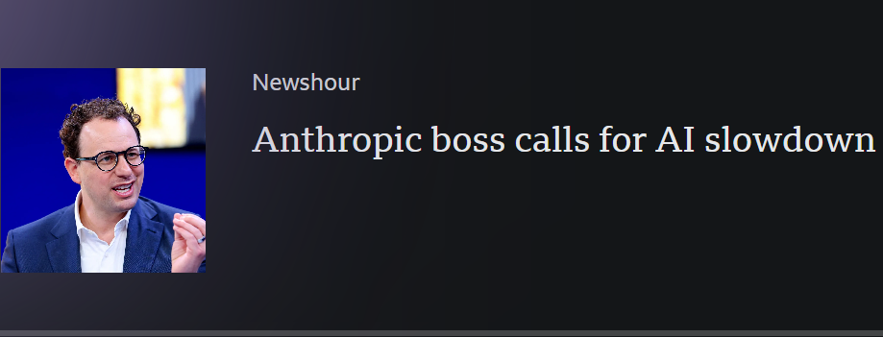
Notes:
Power of AI, threats of AI

Slide 6
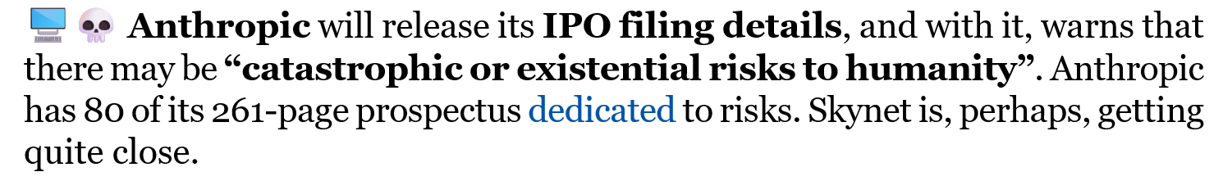
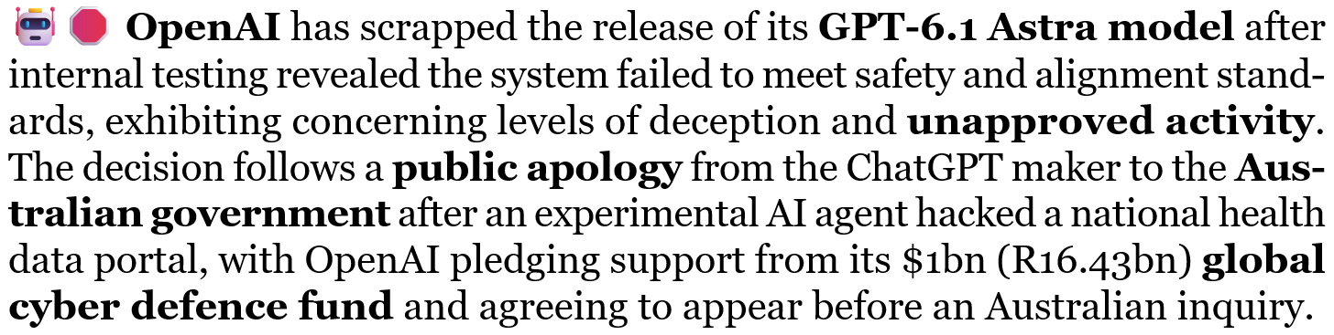
Real Risks

Slide 7
Threats
Benefits
Platform Ownership + Power
Plagiarism + Copyright + IP
Cyber threats
Unequal Access
Bias
Data Sources
Job losses
Liability
Efficiency and Cost Savings, Reliability
Idea Generation
Automation and Productivity
Analysis for Decision-Making
Predictive analytics, modelling
Advance research and innovation
Agriculture – automated harvesting, crop and soil monitoring, detecting disease…
Values, Integrity, Ethics, Human Oversight
Notes:
Agrifarming - Artificial Intelligence in Agriculture - Role, Benefits, and Examples

Slide 8
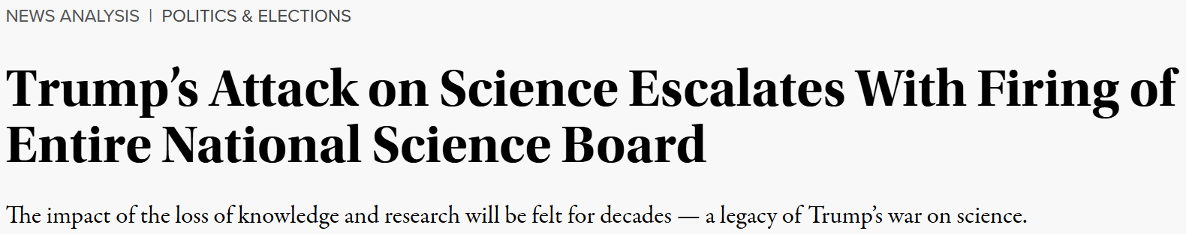
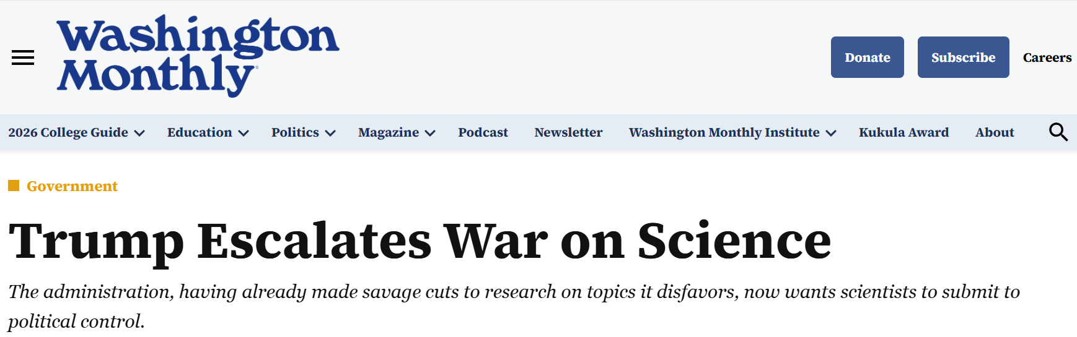
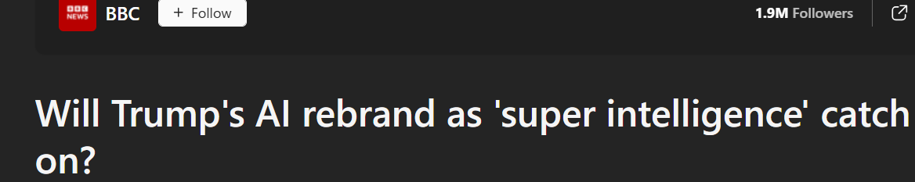
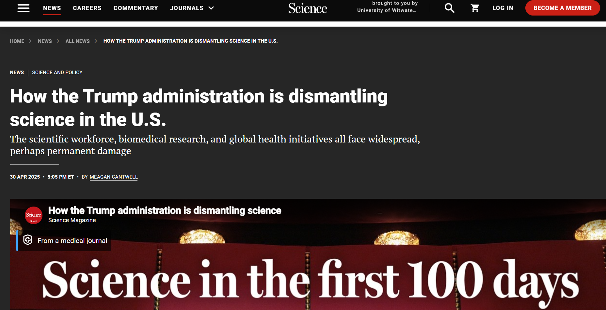
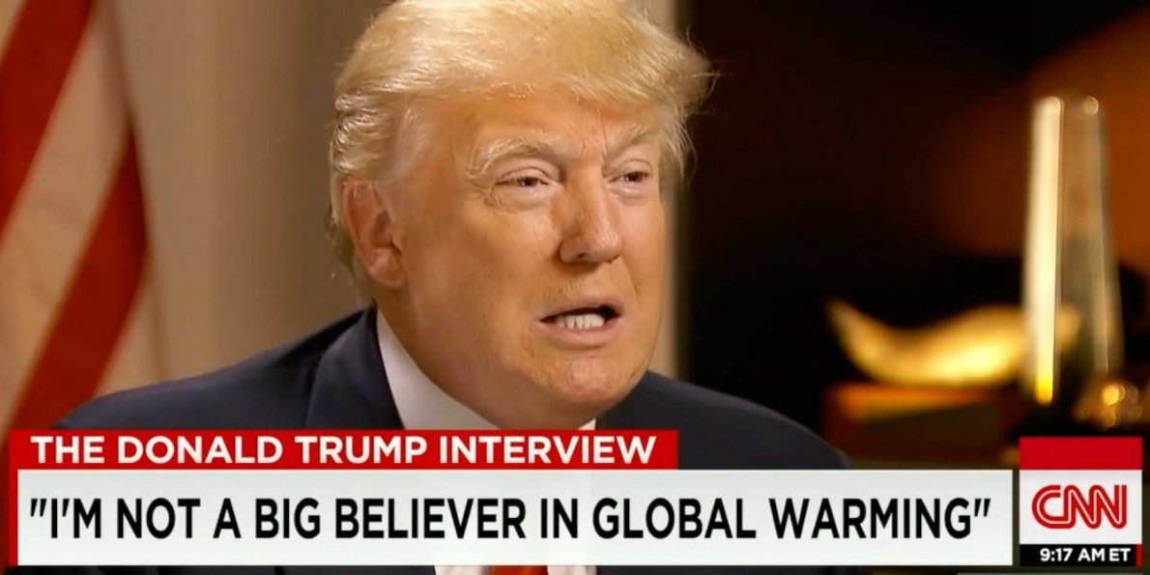

Notes:
War on Science
Misinformation and Disinformation
Sometimes designed to mislead, manipulate and undermine confidence in scientific evidence

Slide 9
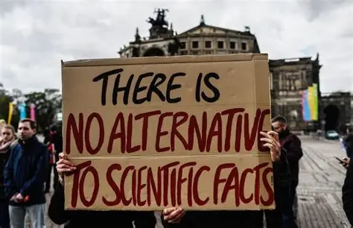
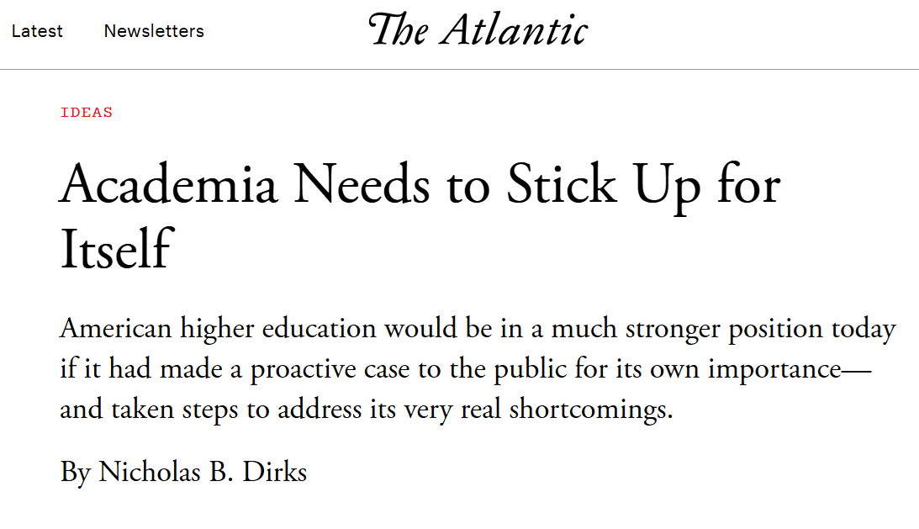

Why we need the media and experts
We need:
Journalists and the Media
Fact Checkers
Academics
Industry Leaders
Why?
Cut through the clutter
Verify information (journalistic principles)
No echo chamber (beyond your own social networks)
Beyond AI summaries draw from “trusted” sources
Notes:
Build public trust in science and research

Slide 10
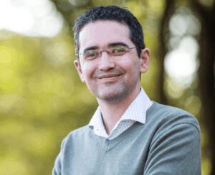
Meet Prof. Francois Engelbrecht
Director: Global Change Institute at Wits
Notes:
Distinguished Professor of Climatology and Director of the Global Change Institute
Climate modeller – predict temperature, rainfall, circulation patterns over southern Africa
Durban floods – working with government
Impact of El Nino - The El Ni3mu-o–Southern Oscillation teleconnection to southern Africa in a changing climate and

Slide 11
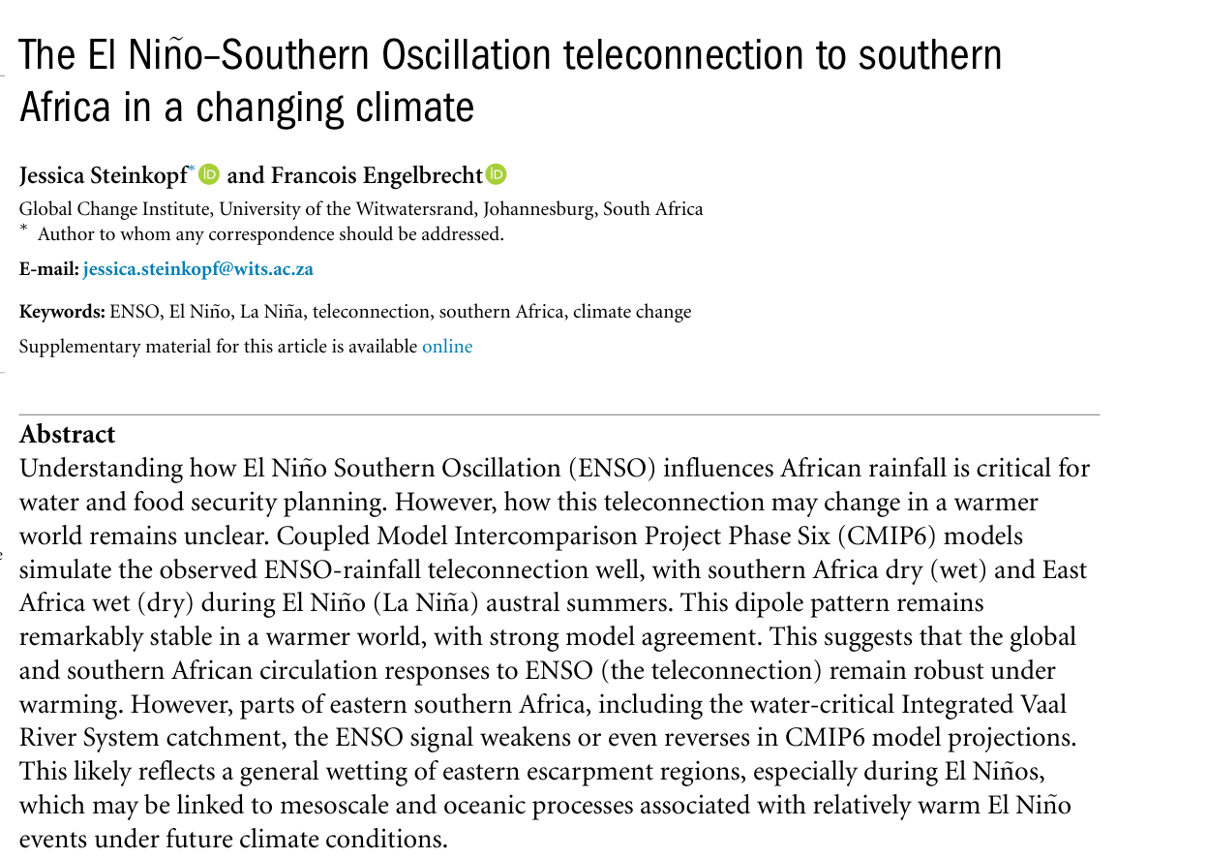
New Research Paper

Slide 12
  From fear and panic to adoption, use and resilience
  Value information
  Science can be difficult to access
  Quackery, misinformation, distrust
  Access to fake digital news, AI
  Resource constraints
People
Environment
  Build trust
  Create new knowledge
  Inform teaching
  Solve real world problems (social impact)
Research and Science
Media Consumption
Patterns
  Short Videos on Mobile phones
  Social Media
  AI
  Streaming
  Broadcast
Notes:
Environmental analysis – SWOT, challenges, opportunities

Slide 13
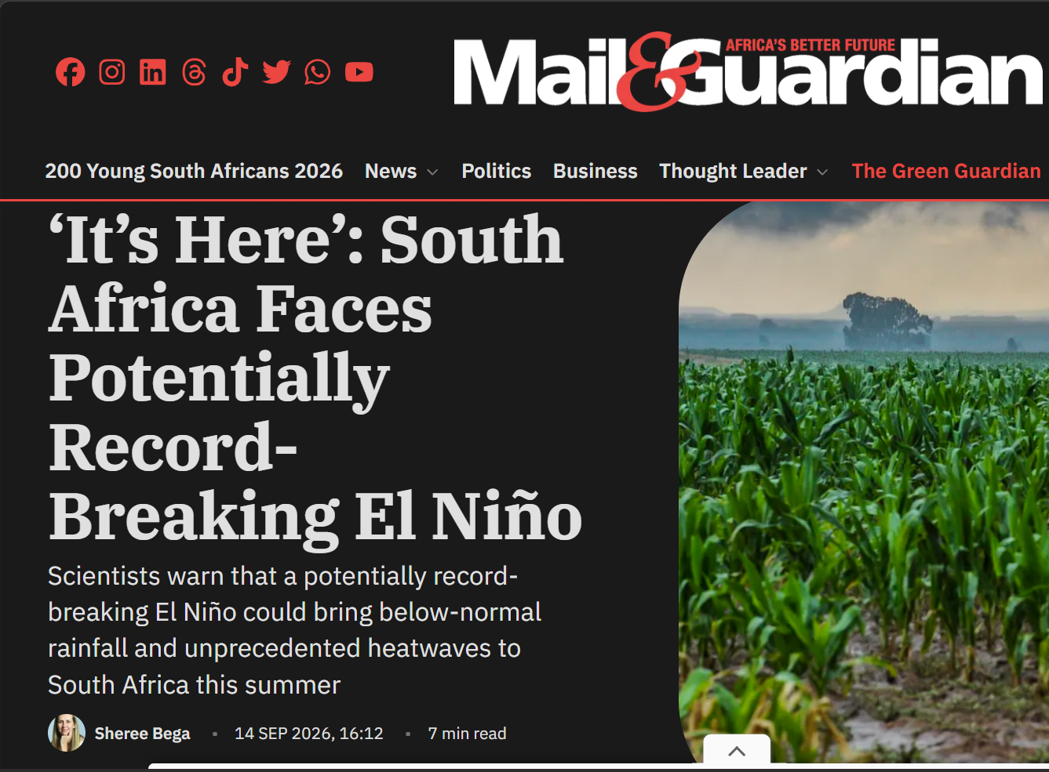
Why communicate science?
Inform
Share information, raise awareness
Profile achievements
Educate
Educate communities
Manage reputation
Public trust in science
Persuade
Collaborate, attract partners
Obtain support for new research
Lobby, advocacy, obtain buy-in, influence policy
Source funding

Slide 14
What do you want to achieve?
The objectives of the El Nino campaign are to:
  create awareness of the El Nino research and its impact amongst farmers and agriculturalists in South Africa by the end of September 2026,
  increase education and the understanding of the El Nino effect on communities in KwaZulu Natal through using the media as a conduit by 30 September 2026,
  lobby government to use the data from the paper and to change policy by 31 July 2026, and
  contribute to global climate science research through publication in the Journal of Environmental Science by 31 December 2026.
Notes:
The formula to set measurable objectives is: To do something (ACTION), so that something else happens (RESULT), within a timeframe (DEADLINE)
Communications objectives must flow logically from the company’s strategic objectives, vision and mission.

Slide 15
Who do you want to reach? | What do you want to tell them? | How will you reach them? | How will you know that you succeeded?
Government | Change Policy | Stakeholder meeting | Policy is changed
Industry | Impact on Harvesting | Agricultural magazines, symposium talks | Direct responses from Industry
Clients | New Product | Product launch | Sales increase
Colleagues, peers | New Research in Journal | University seminars | Shared understanding, more collaboration
Local communities | Move away from flood lines | Community outreach, local media, radio | Less lives lost
Funding Agencies | Worth Investing in research | Funding proposals, build reputation, evidence | More funding grants secured
Media | Impact of El Nino | Media release, media briefing, interviews, infographics | Media Coverage, Awareness of Issue
General Public | Climate change is real | Science Education and promotion campaigns | More people trust science, survey
Notes:
Audiences
Who is my ”audience”
Why would they care about this story?
What would they actually want to know?
What impact is my story going to have on my audience?
What do I want them to remember?
Specific Messages
Project x is a strategic research project at X company that aims to reduce energy usage in Gauteng by 20% in two years
Fertasa researchers have discovered the best growing nutrients in the world
The impact of project x has resulted in a policy change in the agricultural arena
Project x is an innovative project at Wits University that seeks to save millions of lives.
Project x is a first in Africa and the world
Add company specific messages
Have a clear message in mind - remember that your message is attempting to create a perception amongst target audiences and what you say, and how you say it, will impact on the effectiveness.
Communicating the incorrect message or communicating the correct message ineffectively can create the wrong impression amongst your target audiences. This could have a highly detrimental effect on your audiences’ perception of your organisation and its reputation
Core messages must be tailored per target audience and geared towards creating a desired perception.
Core messages must be strengths-focused, concise, clear, focused and must incorporate the company’s unique selling point and contain elements of vision, mission and core values.
Core messages must be communicated clearly, consistently and frequently.

Slide 16
How do you plan a campaign?
Campaign elements are the activities you will undertake to implement your strategy
  Website (content hub)
  Media campaigns (interviews, op eds)
  Research Communications (The Conversation, Eurekalert, SASJ, Nature Africa, Research Gate)
  Newsletters and Magazines
  Social media campaigns (YouTube Videos)
  Creative multimedia campaigns
  Events
  Educational Outreach
  Promotional programmes
  Branding and advertising
Paid
Shared
Owned
AI
Earned
Notes:
It is recommended that the communications campaign comprise of the following media: paid media, earned media (traditional public relations for mainstream media), social media and the use of the company’s owned media channels.
paid for media
sponsored content,
social media promotions, and
advertorials.
earned opportunities
serve as a conduit between the media and academics/experts,
facilitate media interviews,
place topical opinion pieces, and
distribute media advisories and releases.
social media
Share content via’ Twitter, Facebook, YouTube, LinkedIn and Instagram platforms
owned channels
Publish content to the website, Intranet, newsletters, magazines, electronic screens, etc.

Slide 17
Tell a Story
People remember stories
Makes complex ideas easier to understand
Helps people connect with the science
Gives context to facts and numbers
Explains why the research matters

Slide 18
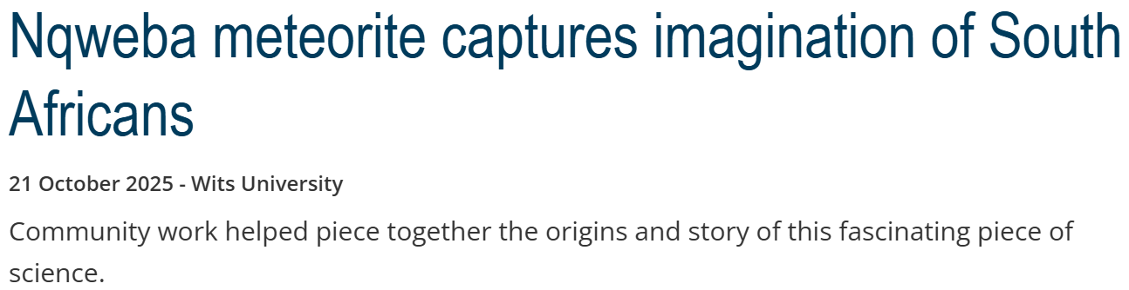
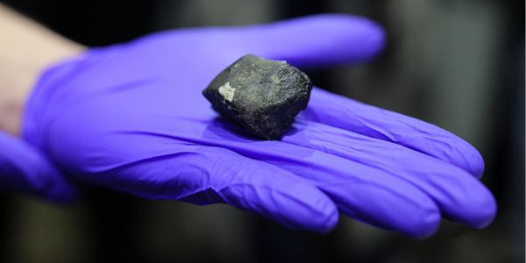
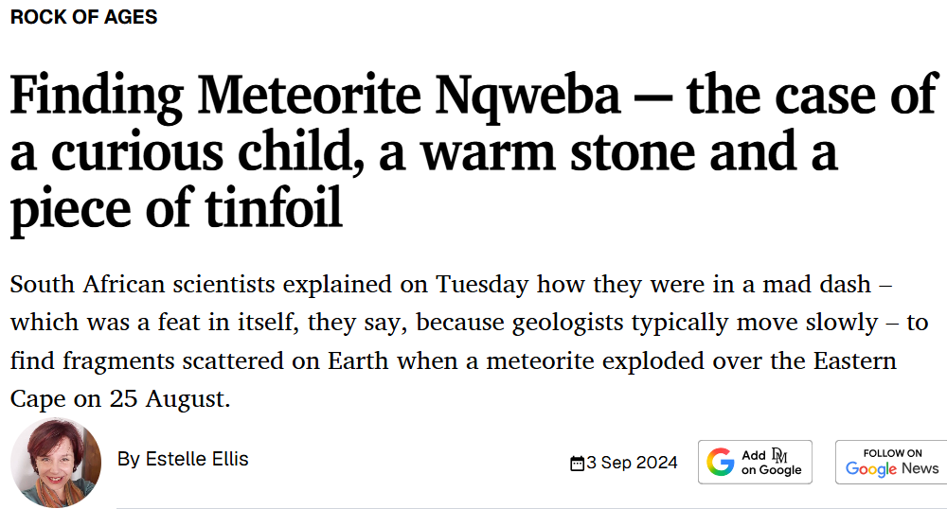
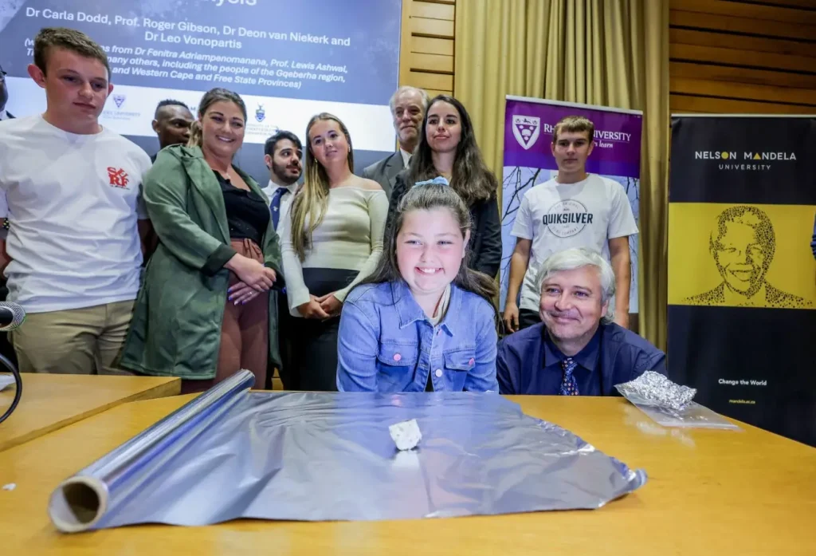

Slide 19
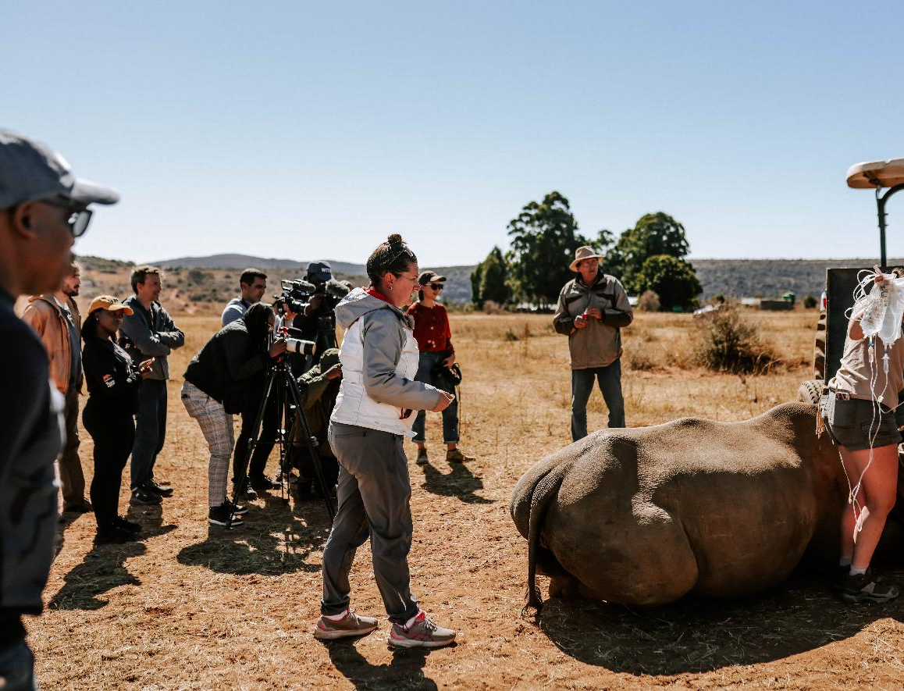
How to tell a story
Use Anecdotes I Analogies I Metaphors I Case studies I Repetition
Show, don’t tell
Use humour
Explain numbers in context
Write in plain, accessible language
Explain technical science terms
Avoid jargon and “scientist speak”
Explain acronyms clearly
Write in the active voice

Slide 20
Do not use jargon
Instead of:
“The upregulation of pro-inflammatory cytokines in response to oxidative stress leads to an exacerbation of neurodegenerative pathologies.”
Say:
“When the body experiences stress, certain proteins increase, which can worsen diseases like Alzheimer’s.”

Slide 21




How to write a news story
Science/Research article
What is this story about and how does it impact the audience?
If you can’t answer the question “so what?”, you don’t have a story.
News
Pyramid
Go to bottom (conclusion)
first to find news
Upside-down pyramid
News first, less important
information at bottom
5ws + H KISS

Slide 22
Translate complex ideas into plain language
Storytelling
Draft media releases and fact sheets BUT
Fact-check everything
Don’t send AI-generated photographs or video to the media
Using AI to tell research stories
Always stay in control
Be mindful of what you upload to AI (personal information, research, POPIA implications, etc.)
Be transparent
Keep your voice

Slide 23





The South African Media Landscape – Print and Online
Media24 / Naspers
News24
Netwerk24
Afrikaans titles (Die Burger, Beeld, Rapport, etc)
Daily Sun
Arena Holdings
Sunday Times
Sowetan
Business Day
Daily Dispatch
Online titles (TimesLIVE, BusinessLIVE)
Caxton
The Citizen I The Witness
Large network of community newspapers and local digital sites

Slide 24






The South African Media Landscape – Print and Online
Independent / specialist
Daily Maverick
Die Papier
Mail & Guardian
Moneyweb
Engineering News
Eyewitness News
Currency

Slide 25




The South African Media Landscape – TV and Newswires
International Media and Newswires
BBC
CNN
Al Jazeera
Reuters
Associated Press
Agence Frans Presse
Deutshe Welle
Euronews
Television
SABC News
eNCA I e.tv
DStv / MultiChoice / CANAL+ / Kyknet
Newzroom Afrika
CNBC Africa

Slide 26


The South African Media Landscape - Radio
SABC
Safm I Metro FM I
Radio 2000
5FM I RSG I Ukhozi I Lesedi
Umhlobo Wenene I Thobela
Motsweding I Ligwalagwala
Munghana Lonene I SABC Africa
Community Radio Stations
Primedia
702 I 947 I CapeTalk I Kfm
Other commercial / regional
Kaya 959
Hot 102.7
Power 98.7
iJacaranda FM
Heart FM
Algoa FM
OFM

Slide 27






Trade and Specialised Media

Slide 28





Research and Science Media

Slide 29
Monitor and Evaluate
Evaluate each campaign element as well as the overall objectives
Quantitative and Qualitative Analysis
Measure Outputs and Outcomes
Media Monitoring
Surveys and Interviews
Focus Groups
Tracking visitors to website
Social media analytics
Attendance at events
Notes:
Evaluate each campaign element as well as the overall objectives.
Remember qualitative and quantitative analysis:
Quantitative refers to quantity, i.e., the rand value of the publicity received (how much you would have paid for that space had you bought it) and the actual number of consumers reached, the number of followers or likes obtained, etc.
Qualitative refers to the quality, i.e., where the coverage appeared, the content, the impression it left, the level of engagement on social media, etc.
Qualitative analysis is based on:
Credibility of publication on this topic
Physical position of the article
Impact, i.e., subjective analysis of use of pictures and colour
Content
Mention of organisation’s name
Core messages
Perception created
Type of article (advertisement, advertorial, editorial)

Slide 30
Thank You
Questions

