Slide 1




Science, Research and Policy
A Need for Coalescence
Pieter Raath
Dept. Soil Science
Notes:
Thank you – organisers invitation; arrangements; a privilege.
Imagine a dangerous, fog-shrouded coast where ships constantly crash. To save lives, the townspeople must build a lighthouse, but it requires 3 distinct elements to work as one:
Light and a Lens – this is the foundational aspect determining the success of the lighthouse. If they do not draw on the basic scientific laws of optics and the physics of luminescence, there will be no light to pierce the darkness.
Secondly, ongoing investigation by a navigator and a mapmaker, who studies the shifting tides, track where the ships actually crash, test which light frequencies pierce the fog the best and interview the sailors.
And the last element is the instructions, rules and procedures for the Tower Keeper. He must follow them meticulously to ensure the tower is in perfect working condition - the safety of the ships is at stake.
Without all three of these elements, the town and his people will not have a functioning lighthouse to save ships from crashing.

Slide 2
Science, Research and Policy
A Need for Coalescence
Pieter Raath
Dept. Soil Science
Notes:
Coalescence is the process where separate elements or parts merge, blend, or grow together to form a single, unified body or system.
It signifies a union of diverse components.
I hope I can succeed today, and I will try my best, to communicate to you the extent to which Science, Research and Policy can be integrated in a value system to the benefit of the environment, producers, fertiliser companies and also to keep consumers of agricultural products happy (if that is possible).

Slide 3
Fertiliser Industry
Fertiliser Market/Farmers
Consumers of Products
Notes:
By way of introduction, allow me to set the scene for my talk by asking...

Slide 4
Fertiliser Industry
Fertiliser Market/Farmers
Consumers of Products
Notes:
Do you agree that most of the time the sources of influence that dictates the way fertilisers are used are illustrated by the arrows?
By this, I mean that both the FI and Consumers try, and frequently succeed, to influence how much and what fertilisers the producers use.

Slide 5
In-house Technical
Advisors
Dealers
Fertiliser Industry
Fertiliser Market/Farmers
Consumers of Products
Notes:
The FI does it through in-house technical support and associated advisors or dealers.

Slide 6
In-house Technical
Advisors
Dealers
Fertiliser Industry
Fertiliser Market/Farmers
Consumers of Products
Concerns/fears
Supermarkets
Legislation
Notes:
Consumers do it through supermarkets or legislation, driven by environmental concerns, food security or food safety fears

Slide 7
Fertiliser Industry
Fertiliser Market/Farmers
Consumers of Products
?
?
Notes:
The question is: “To what extent do, or can Producers influence or dictate fertilization practices themselves?”
One would argue that it is wholly their right to fertilise as they please.
But in reality, do they really follow their own minds? How can they make sure the fertilisation practices are correct; optimal for their crop and production system?
Where do they go for independent help? Is it consultants? Is it scientists/researchers/universities?
If I was a farmer today… “my keel sal toetrek…”

Slide 8
International Policy
National Policy
Company Policy
Research
Science
Notes:
I would like to tackle the given topic in the following way:
First, let’s look at policy. Given my background, I will not attempt to go beyond tackling the different policies on a superficial level.
What does International policy enforce on us; specifically on farmers?
Then, what about National policy?

Slide 9
International Policy
National Policy
Company Policy
Research
Science
Notes:
And then, to what extent should these two levels of policy influence the in-house company policy of fertilizer suppliers?

Slide 10
International Policy
National Policy
Company Policy
Research
Science
Notes:
After that we need to state that first and foremost, Science and Research should be dictating these three levels of policy.

Slide 11
International Policy
National Policy
Company Policy
Research
Science
Notes:
But above all, the most logical impact should be on company policy.
What I hope to convey to you today is that we should focus on the one area where we can have an influence, that is company policy.
We should take to heart the impact of International policy on the future markets of producers.
We should adhere to local legislation, and through responsible recommendations protect our clients from doing harm to the environment and thereby getting themselves in trouble.
And this means, that we should allow science and research to be close allies – dictating our logic and shaping our in-house company policy.

Slide 12

International Policy
Notes:
So, let’s start with some International Policies that we need to take note of.
The first is the European Green Deal…

Slide 13

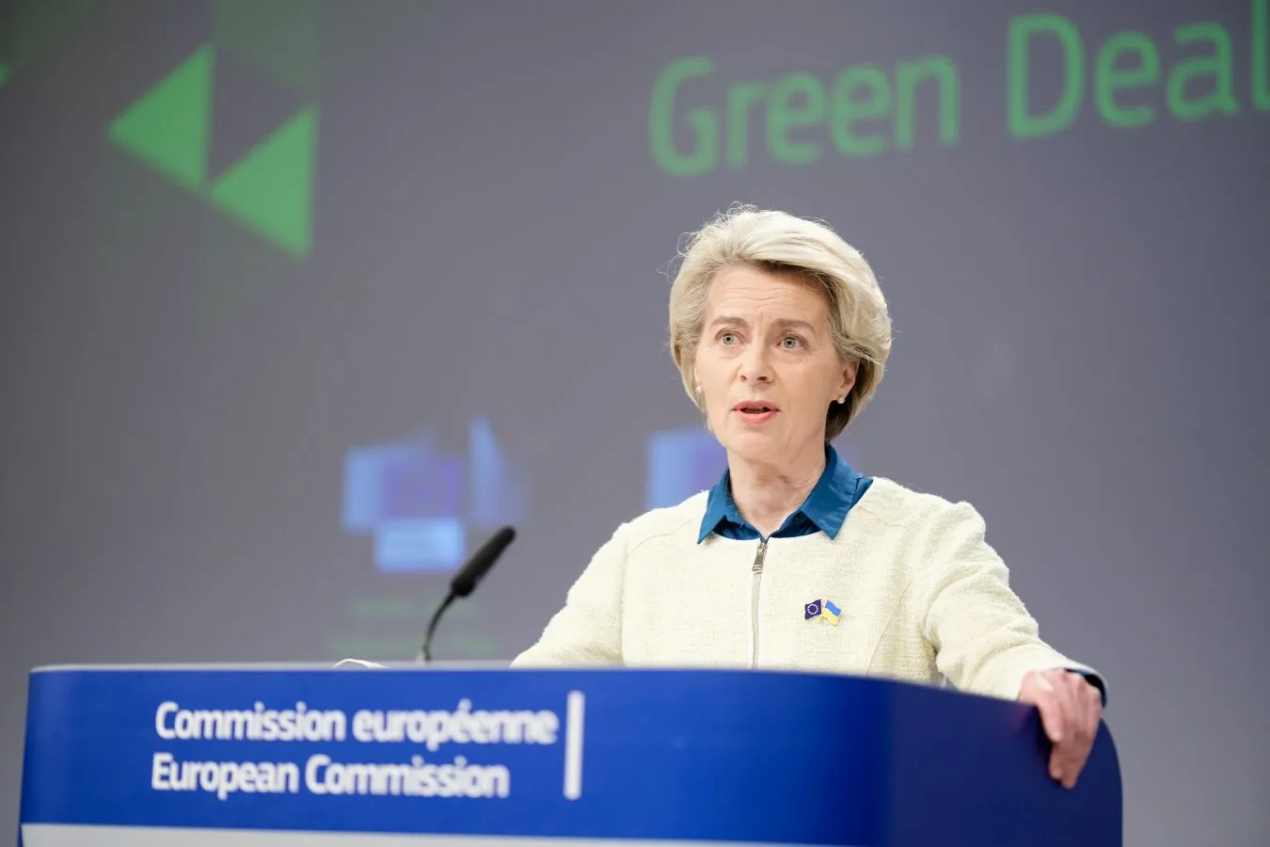
European Green Deal
The core goal was to
set a legally binding target to make the EU climate-neutral by 2050
Notes:
The European Green Deal is a growth strategy that was launched in December 2019 by Ursula von der Leyen to transform the EU into a modern, resource-efficient, and competitive economy.
Its Core Goal was to set a legally binding target to make the EU climate-neutral by 2050.

Slide 14

European Green Deal
Notes:
The framework of the Green Deal reaches far beyond climate mitigation – it also aims for zero pollution, biodiversity restoration, developing a circular economy, and ensuring sustainable food systems. Most of this falls under the "Farm to Fork" Strategy.
Within the Farm to Fork Strategy, the fertiliser sector has become one of the primary battlegrounds of the European Green Deal.

Slide 15
European Green Deal
Clear legal targets was set for 2030:
Cutting synthetic fertiliser use by at least 20%.
Reducing nutrient losses by 50% to prevent water and air pollution.
Scaling organic farming to cover 25% of all EU agricultural land.
Notes:
Apart from seeking a reduction in chemical fertiliser use, the fertiliser sector is also now subject to stringent regulations.
Within the Farm to Fork Strategy, the EU established clear legal targets for 2030:…

Slide 16

Notes:
This brings us to the so-called “Brussels Effect”, of which you probably would have heard.
It is the power of the EU to shape global standards and rules outside its own borders through market forces alone.

Slide 17
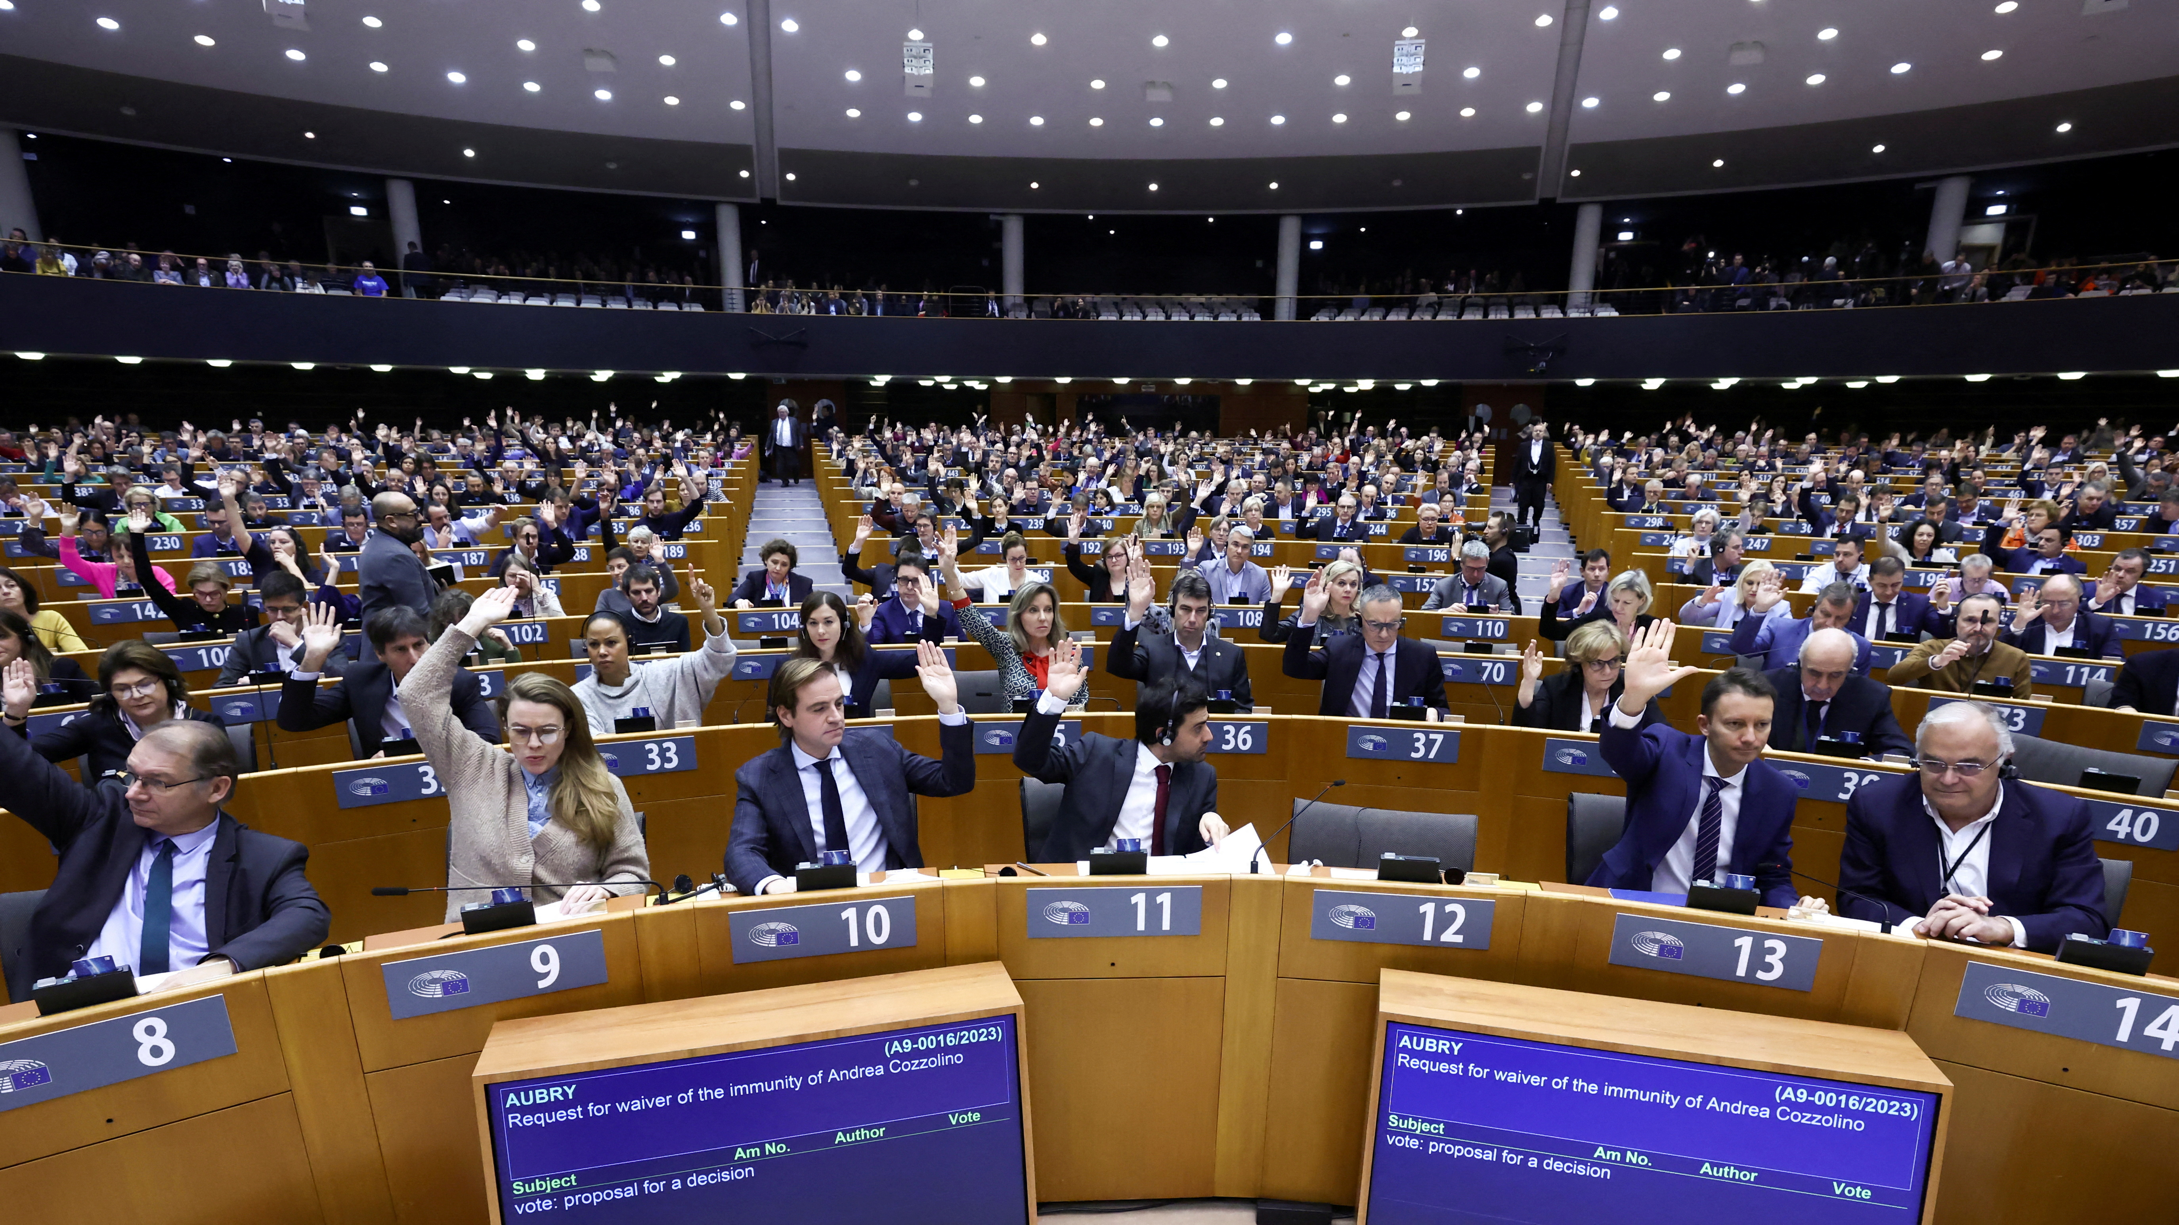
EU Parliament
Notes:
The EU enforces strict environmental and sustainability regulations to apply to imported goods.
So, farmers or any company that want to sell their products in the EU must follow EU rules.
The result is that for exporters to keep their contracts, they push farmers to use fewer synthetic fertilizers and look for organic alternatives.

Slide 18


Fresh produce suppliers to the USA must prove that they meet the same standards required for domestic U.S. farms, as stipulated by the FDA.
Notes:
Likewise, in the USA, foreign suppliers must prove that their use of agricultural inputs, water, and soil amendments meet the same standards required for domestic farms.
Failure to do so can lead to refusal of entry by the Food and Drug Adiministration.
Note also that 36 of their States now have state government laws and regulations that limit the use of commercial fertilizers and also animal manure.

Slide 19

Notes:
The bottom line, as spelled out by BFAP, is that it is very likely that the production practices of exporters of food commodities to the EU and USA will come under increased scrutiny over the next number of years,….

Slide 20
“Anyone who wishes to export crops to the EU will have to adhere to similar input use directives and production system requirements.”
Notes:
…. and anyone who wishes to export crops to the EU will have to adhere to similar input restrictions that is being enforced in Europe.
Likewise, since producers need to be GlobalGAP certified to export produce, they must adhere to the specification regarding fertilisation that is in the GGAP standard, namely . ..
“Fertilization must be based on the nutritional needs of the crop and the results of regular soil analysis.”
------
I think this will suffice as far as International policy goes.
It boils down to pressure on farmers to use fertilisers more prudently if they want to expoirt to Europe and the USA..

Slide 21

South African Policies/Legislation
Notes:
Now, let’s look at some policies within our own country.

Slide 22
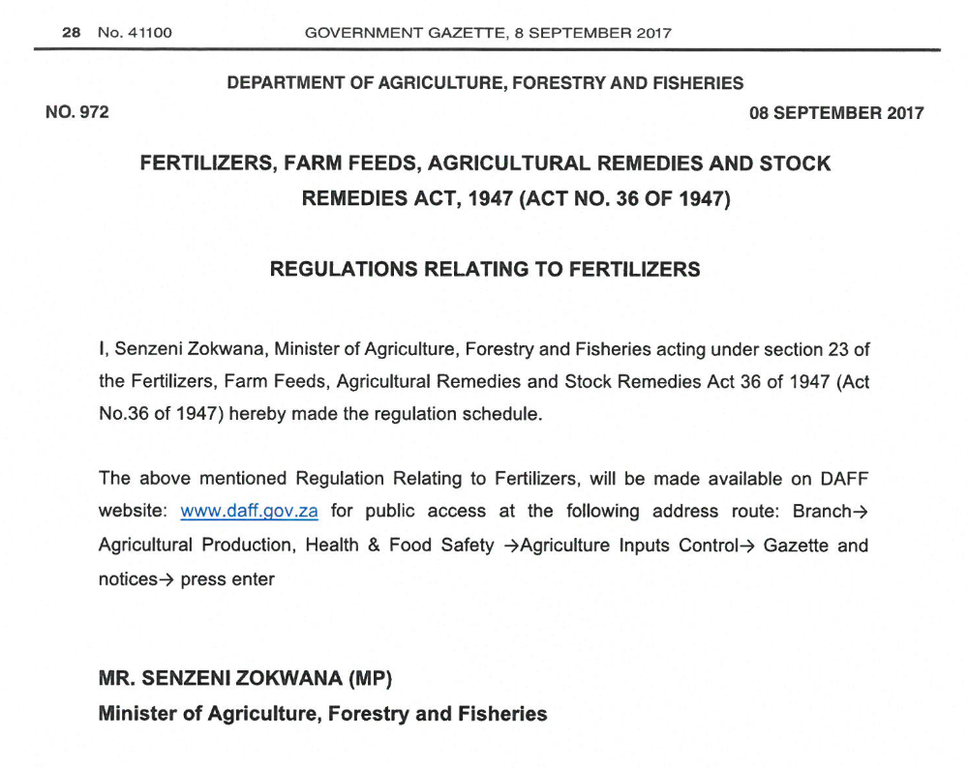
South African Policies/Legislation
Notes:
The first, and foremost is our good and old Act 36 of ...1947. They say some things never change.
But let’s look at some points to note:
Neither this law nor any other in South Africa imposes blanket quotas on how much fertilizer a farmer can use. However, it places strict limits on composition, registration, permissible nutrient deviations, heavy metal thresholds of products and then also on water-resource pollution.

Slide 23
South African Policies/Legislation
The "Label is Law“
Rule
Notes:
Rather than capping total usage, this law limits fertilizer use by mandating product registration.
This is called the "Label is Law Rule”:
Legally, a product, which also seems to include fertilisers, can only be applied according to the approved dosage and directions printed on their registered label.
But we know that most fertilisers do not have a label with dosage instructions. So, with regards to fertilisation, this law does not have much teeth.

Slide 24
South African Policies/Legislation
Preservation and Development of Agricultural Land Act (PDAL)
Act of 2025
Soil conservation
Promotes organic over chemical fertilisers
National Environmental Management Act (NEMA)
Act 107 of 1998
Protection of ecosystems
“Polluter Pays Principle”
Notes:
But we also have other acts to take note of:
Preservation and Development of Agricultural Land Act: Passed in early 2025
This law enforces agro-ecology principles across South Africa. It shifts agricultural practices toward soil conservation, and it promotes organic fertilizers over chemical fertilizers.
Then there is the National Environmental Management Act, which regulates agricultural practices that could cause environmental degradation. If runoff from excessive fertilizer use causes harm to a local ecosystem, landowners face severe penalties under the Law’s "polluter pays principle”.

Slide 25
South African Policies/Legislation
Preservation and Development of Agricultural Land Act (PDAL)
Act of 2025
Soil conservation
Promotes organic over chemical fertilisers
National Environmental Management Act (NEMA)
Act 107 of 1998
Protection of ecosystems
“Polluter Pays Principle”
National Water Act
Act 36 of 1998
Limits discharge into rivers
Controls pollution of water sources
Notes:
And then there’s the National Water Act (Act 36 of 1998): This Act controls the pollution of water resources. It limits the discharge of any agricultural effluent or polluted runoff into rivers and catchments.
None of these laws has any teeth to put a limit on the use of fertilisers by farmers, or a limit on what is recommended to them.
They are reactive – that is – if you messed up and caused harm, you have to face the music.

Slide 26
Natural Scientific Professions Act
Act No. 27 of 2003
Governs SACNASP
SACNASP regulates and oversees
Must be registered with SACNASP
Notes:
Then, maybe fortunately (but I am not so sure), there’s the …. Natural Scientific Professions Act, which governs SACNASP, which is the South African Council for Natural Scientific Professions.
SACNASP is a statutory body that regulates and oversees ethical conduct within the natural sciences in South Africa.
Under this law all practicing natural scientists that work in South Africa must be registered with SACNASP.
So, in the context of the fertiliser industry, this law attempts to enforce the ethical, scientific conduct by company representatives and all consultants who make recommendations to producers.
Do you think it succeeds?

Slide 27
Notes:
Phew, I think that’s enough of the stale laws. I know this is now getting boring.
But we do need to ask: “What else do we have i.t.o. policy in the South African context?”

Slide 28

Notes:
Aaah, there’s FERTASA.
I was pleasantly surprised by FARTASA’s mission

Slide 29
Mission
To provide a credible platform to promote the responsible and sustainable use of fertilisers.
Notes:
To provide a credible platform to promote the responsible and sustainable use of fertilisers.

Slide 30
Mission
To provide a credible platform to promote the responsible and sustainable use of fertilisers.
Vision
To be the representative voice for the fertiliser industry and as the stamp of approval for responsible and sustainable soil fertility and plant nutrition in Southern Africa.
Notes:
And the vision…. To be the representative voice for the fertilizer industry and as the stamp of approval for responsible and sustainable soil fertility and plant nutrition in Southern Africa
If the members of FERTASA upholds this Mission and Vision in their company policies, then our producers are indeed in good hands.
The question is, “Do they ???”

Slide 31

In-house Technical
Advisors
Dealers
Fertiliser Industry
Fertiliser Market/Farmers
Consumers of Products
Notes:
So, consultants and technical advisers that are SACNASP registered, together with the member companies of FERTASA, will therefore make sure our producers do not fertilise in excess of what their crop requires and the markets demand, or what the environment can cope with.
The question is: “Do they?”

Slide 32
International Policy
National Policy
Company Policy
Notes:
Before I move on to the next level, namely “Company Policy”, let’s just consider for a moment what the goal of policy, or even legislation, is.

Slide 33
International Policy
National Policy
Company Policy
Set Clear Expectations
Define expected behaviour, actions and responsibilities
Notes:
At its heart the goal of policies are to define expected behaviour, actions and responsibilities.

Slide 34
International Policy
National Policy
Company Policy
Set Clear Expectations
Define expected behaviour, actions and responsibilities
Create Consistency
Ensure that everyone operate under the same guiding principles
Notes:
And to ensure that people across an organization operate under the same guiding principles, leading to uniform internal processes and external interactions.
In essence, the role of laws and policies are to protect people. In this context, it is to protect the fertiliser provider from acting irresponsibly.
And on the other hand, it is to protect farmers from our temptation to exploit their anxieties or vulnerabilities, or often simply to help us to protect them from their own FOMO.

Slide 35
Company Policy
Notes:
So, when we come to company policy. Please allow me to ask a few sensitive questions.
Should company policy be designed to promote sales?
Or should it be to protect the interests of one’s clients and employees, …and in the process protect and enhance the reputation of the company?

Slide 36
Company Policy
Notes:
Some of you might know that I own an agricultural laboratory – our motto at the lab is: “If our clients are successful, we are successful”.
We have learnt that we can provide the best analysis results, but if we do not carry our client’s interests at heart, the team in the lab start to struggle – they loose their sense of purpose, and they become discontent and unhappy.
And then our clients will pick up on that and start doubting our service and commitment to them. This is not where one wants to be, is it?
So, from a business point of view, we have one policy. That is to make sure our service makes our clients successful.
It is worthwhile to take note of the capital value of a trust relationship – one that’s earned through ethical, honest concern for your client.
Should this concept not shape company policy?

Slide 37
International Policy
National Policy
Company Policy
Research
Science
Notes:
Now, at last, let’s talk about Research and Science – and how that fit together…

Slide 38
International Policy
National Policy
Company Policy
A Science Policy
Research: systematic study to increase knowledge & solve problems
Science: unchanging, reliable body of facts & laws
Notes:
It is logical that Science and Research should to inform, support, and refine policy decisions. Basic facts and evidence are at the heart of tackling the challenges our clients face.
The connection between science and research with our recommendations is something we cannot move away from. If we stop developing it; and forbid that it happens, if we purposefully destroy this relationship for the sake of selling more product, the consequences to one’s company and one’s clients will be dismal.
I want to suggest that: “One should aspire for your company to build or develop a relationship between science, research and policy that is better than your competition.” Can you think of a more noble and worthwhile marketing strategy?

Slide 39
International Policy
National Policy
Company Policy
A Science Policy
Research: systematic study to increase knowledge & solve problems
Science: unchanging, reliable body of facts & laws
Notes:
Scientific and research data should inform and help policy-makers to come up with policies that demonstrate a subservience to the truth.
Scientific and research data should shape the ethical code of the company.
Scientific and research data should be seen as your friend, not foe.
I am sure, like me, you will trust someone who is subservient to scientific fact.
Are you someone who has a desire to be right, or are you pressured by unwritten company policy to prove yourself to be right at all cost.

Slide 40
Notes:
At this point, I want to illustrate from the citrus industry a reality that we need to take note of.

Slide 41
Notes:
If we draw a graph that correlates the size of an expected citrus crop to the recommended total annual N prescribed, we would expect a fairly good, positive correlation, right? Well, up to a point….

Slide 42
Notes:
Now, in this graph I plotted 160 fertilizer recommendations that I could get hold of. The different colour dots represent recommendations by different persons or companies.
Note specifically the red, green and blue dots.

Slide 43
Notes:
In the case of two, there’s a rough correlation between recommended N and expected yield. But not in the case of the green dots.

Slide 44
Notes:
Now notice a fourth company, represented by the orange and yellow dots… Is this not what one would expect to see? A way better fit.
One can argue that a recommendation is certainly based on more than one factor, not just expected yield.
But, this does not explain why the recommendations of company red are all above 250 kg/ha, and those of company blue are all between 180 and 260 kg /ha.

Slide 45
Notes:
If we now express the programmes in a different way, i.e., kg N prescribed per ton of fruit, one gets this picture.
If one accepts that 3 kg N per ton of fruit is a fair to luxurious fertilization rate, then companies green, blue and red are in all cases above that rate.
Yes, there might be reasons from leaf analysis, growth, alternate bearing why the rate differs from one block to another.
But note, all the green, blue and red recommendations end up above the line. This illustrates a baseline fertilization level that’s been set, and too high.

Slide 46
Notes:
I calculated that 2/3rds of the recommendations lie above the 3 kg N/ton of fruit level. This limit is luxurious, but based on various research projects. Why is it ignored? What happens to the excess N?
How will our producers defend this, when confronted about it?
Can their fertiliser providers and consultants then come up with a scientific defence?

Slide 47

We should avoid basing recommendations on popular science
Notes:
Another point I want to make is that we should avoid thinking that because a specific logic is common, it is true.
We should never stop questioning our scientific beliefs, our set norms and formulas, even when it’s been taught to us by colleagues in our companies. We must always seek to maintain objective scientific perspective.
Reliable research outputs and researchers should be shaping our thinking and beliefs. And we must be willing to HAVE it shaped.

Slide 48

We should try to avoid corporate pressure
Notes:
I am using typical rhetoric, and I know I am probably wasting my breath because many people are in a dilemma, a catch-22 situation.
It reminds me of a rule in the World War II British Military Rulebook: Namely that a scared pilot can only be excused from dangerous flights if he is declared insane. However, if he wants to avoid danger it shows normal survival instincts—which proves that the pilot is actually sane; which means… that he must keep on flying.
A similar catch-22 logic can make it difficult to employees, since company shareholders expect a certain turnover, and has set sales goals for specific products. This leads to company policy which, unfortunately, prefers to ignore sound science and research, because it is counterproductive to the expected bottom lines.

Slide 49
Company policy:
We should exploit the capital value of gained trust and good repute
Notes:
This is a sad situation.
As a researcher, I am used to various companies, and especially their agents, becoming agitated or irritated with me when I present my research results.
Instead of them taking note of it and using it to improve their recommendations, the results are ridiculed – why?
Is it because the results do not correspond to their rationality,… or may I say, to the unwritten company marketing policy?
I want to repeat myself: We should rather exploit the capital value of gained trust and good repute that originates from a subservience to sound science and research.

Slide 50
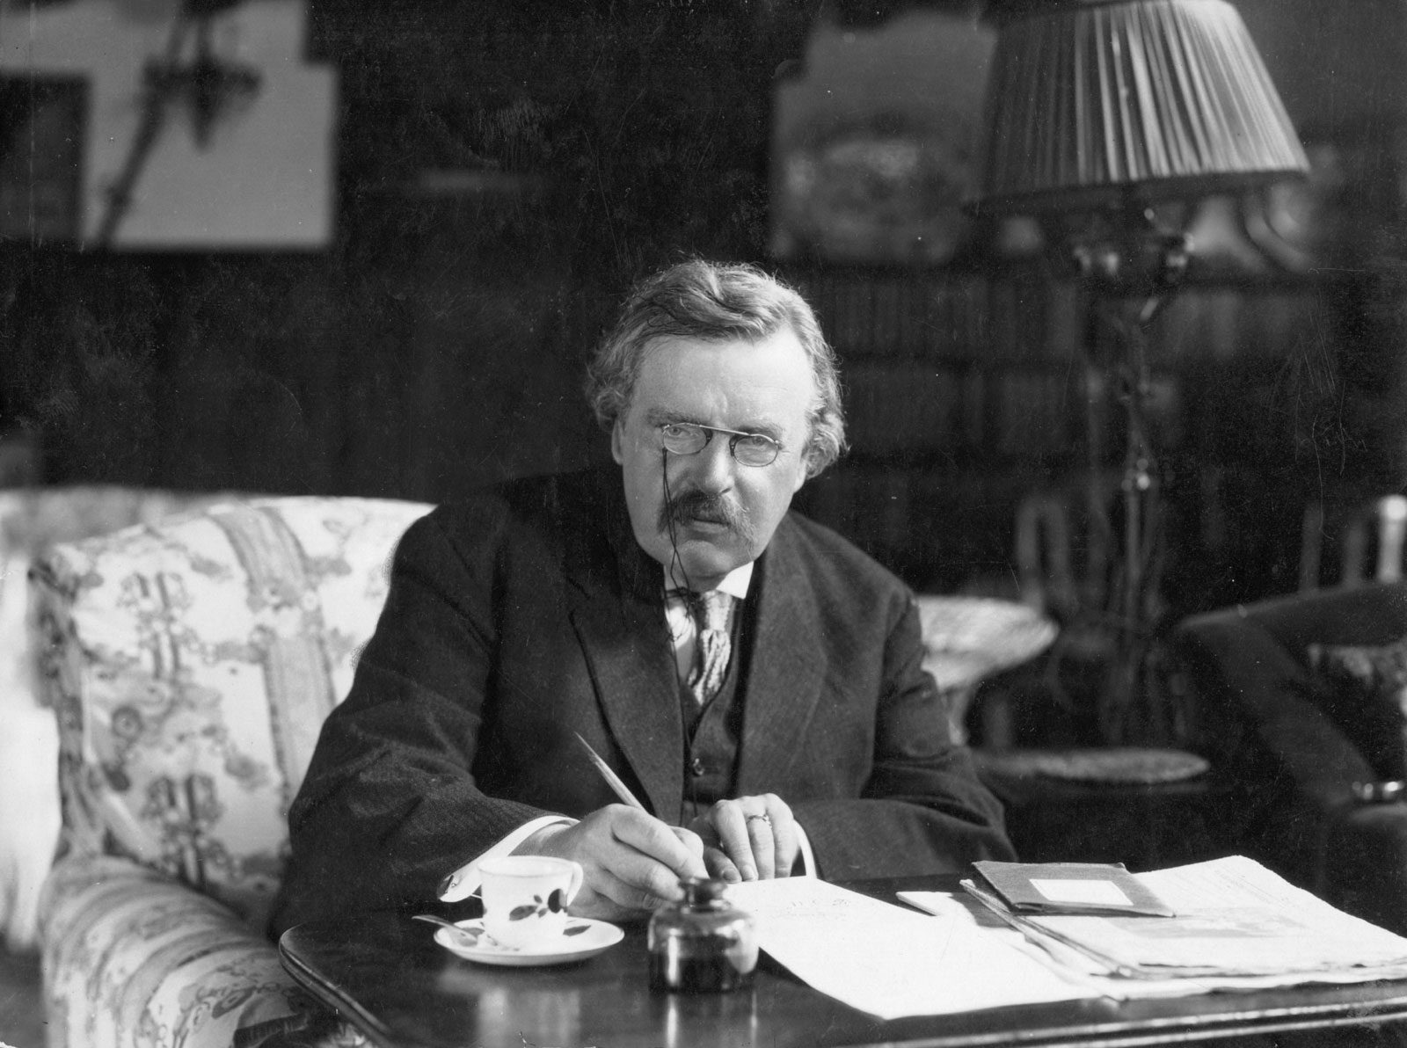
The answer to the question
'What is Wrong?’ is, or should be, 'I am wrong.’
Until a man can give that answer,
his idealism is only a hobby.
G.K. Chesterton
Notes:
In 1905 a London newspaper asked prominent authors "What is wrong with the world today?“, G.K. Chesterton replied in the following way:”
The answer to the question 'What is Wrong?’ is, or should be, 'I am wrong.’ Until a man can give that answer, his idealism is only a hobby.
This challenged me – I can have my ideals, and I can think I am doing the right thing with my truthful attempts to persuade the world of my scientific accuracy, while never being open to the fact that I might actually be wrong.
Until a man can admit that he is wrong, all his idealism remains only a hobby

Slide 51
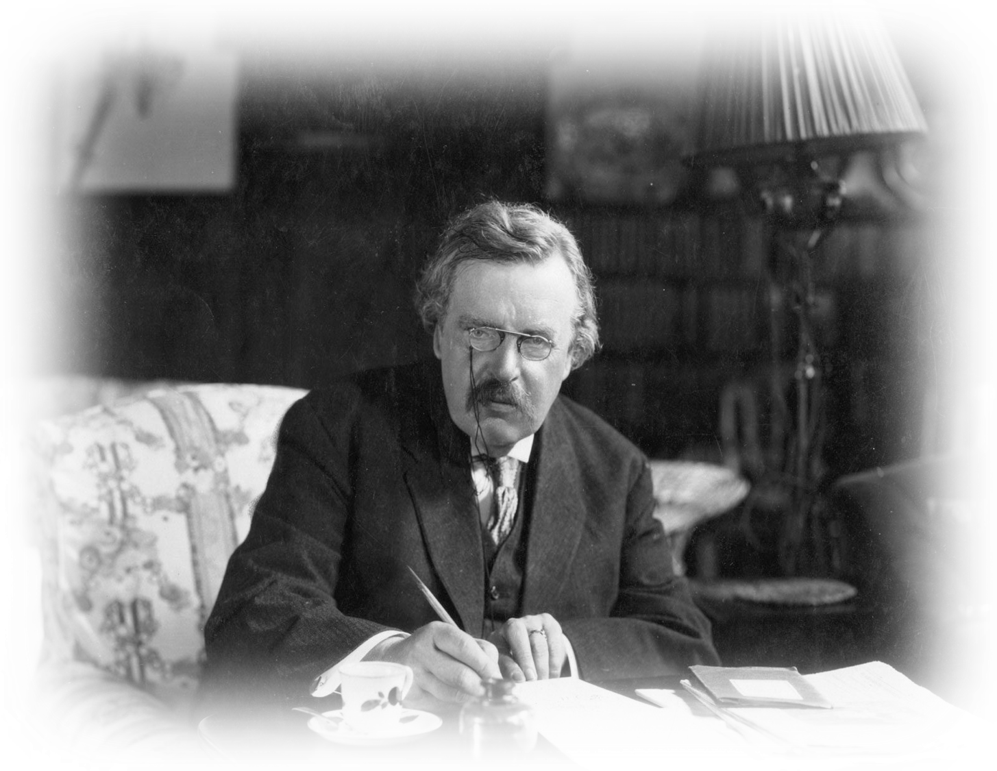
Do you have a desire to be right, or do you have to be right at all cost?
Notes:
So, I ask, are you someone who has a desire to be right, or are you pressured by unwritten company policy to have to prove yourself to be right at all cost?
The desire to be right is something we all need to work on, that includes myself. It’s not something that comes naturally to us humans.
----
There is a pleasant example is one company I often deal with in the Western Cape. Despite the pressure to sell product, the team are very serious about making correct, defendable recommendations, which in my opinion often leans to the too conservative side. Is this not a company you want to work for, or with? Or from whom a producers want to buy his fertilisers?

Slide 52
We should avoid basing recommendations on popular science
Notes:
Please allow me to touch on one example of how science and research should not be used.
I think it is a very good example where people think that because a specific logic is common or popular, it must be true – true in all cases.
Or, because it is a concept accepted by many people, it tends to be misused.

Slide 53
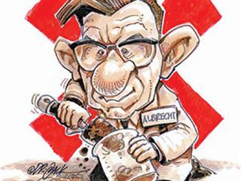
The Base Cation Saturation Ratio (Albrecht) Concept
Picture courtesy of Farmer’s Weekly, April 2013
Notes:
Yeah – the Base Cation Saturation Ratio Concept, commonly associated with prof. Albrecht from the University of Missouri in the 1930’s & 40’s.
He argued that soil fertility depends on the relative balance of basic cations—calcium (Ca), magnesium (Mg), and potassium (K), and Na was later added.

Slide 54
The Base Cation Saturation Ratio (Albrecht) Concept
The Albrecht System:
Uneconomical & outdated?
Chaganti, V.N., Culman, S.W., et al. 2021. Base cation saturation ratios, soil health, and yield in organic field crops. Agronomy Journal 113:4190-4200.
Culman, S.W., Brock, C., et al. 2021. Base cation saturation ratios vs. sufficiency level of nutrients: A false dichotomy in practice. Agronomy Journal 113:5623-5634.
Edmeades, D. 2011. Base saturation ratios – why they are nonsense. In agKnowledge’s Fertiliser Review 26: 1-4.
Kopittke, PM & Menzies, NW. 2007. A review of the use of the basic cation saturation ratio and the ‘ideal’ soil. Soil Science Society of America Journal 71: 259-265.
McLean, E.O., Hartwig, R.C., Ecjert, D.J. & Triplett, G.B. 1983. Basic cation saturation ratios as a basis for fertilizing and liming agronomic crops. II. Field Studies. Agronomy Journal 75(4): 635-639.
Liebhardt, W.C. 1981. The basic cation saturation ratio concept and lime and potassium recommendations on Delaware's Coastal Plain soil. Soil Science Society of America 45(3):544-549.
Thibaud, G. 2012. Liming and the relevance of soil calcium and magnesium ratios. Fertilizer Society of South Africa Journal: 69-84.
Picture courtesy of Farmer’s Weekly, April 2013
Notes:
In an opinion piece published in the Farmer’s Weekly in April 2013, sixteen prominent South African Soil Science academics refuted the relevance of this 70-year-old system – they di that on the basis that advances in soil science show the system is scientifically unsupported.
They also quoted some peer-reviewed articles to support their concerns, to which I have added some more.

Slide 55
We should avoid basing recommendations on popular science
The Base Cation Saturation Ratio (Albrecht) Concept
“There is consensus among soil fertility scientists that BCSR is not a legitimate practice of soil management”
Culman et al., 2021
Notes:
And I want to quote two of the authors.
Culman et al, referring to scientists in the USA: “ There is consensus among soil fertility scientists that BCSR is not a legitimate practice of soil management”

Slide 56
We should avoid basing recommendations on popular science
The Base Cation Saturation Ratio (Albrecht) Concept
“There is consensus among soil fertility scientists that BCSR is not a legitimate practice of soil management”
Culman et al., 2021
“Research shows that use of these saturation percentages and the resulting Ca/Mg, Ca/K, and Mg/K ratios is not warranted and may result in reduced yields or increased costs, or both.”
Liebhardt, 1981
Notes:
And Liebhardt stated that “Research shows that use of these saturation percentages and the resulting Ca/Mg, Ca/K, and Mg/K ratios is not warranted and may result in reduced yields or increased costs, or both.

Slide 57
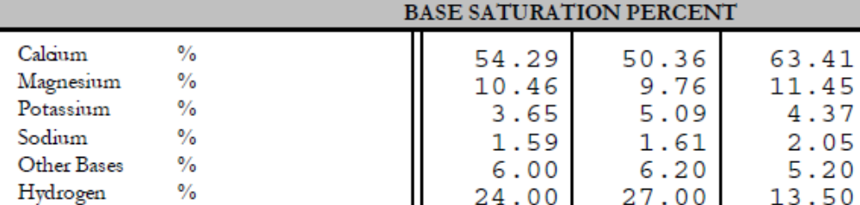
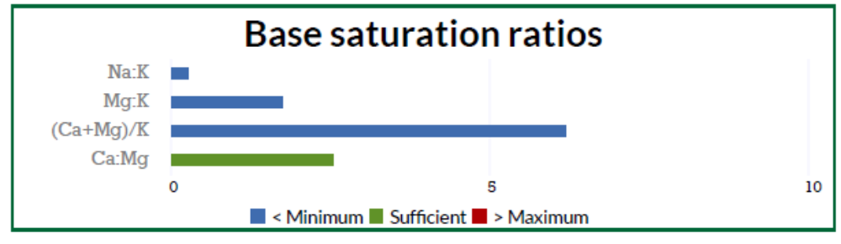
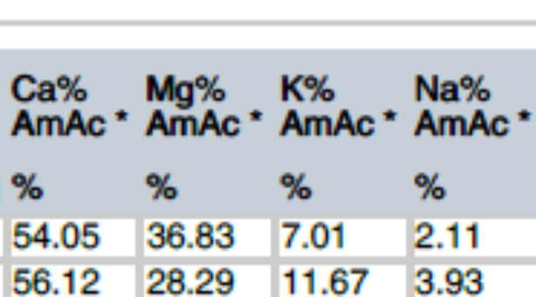
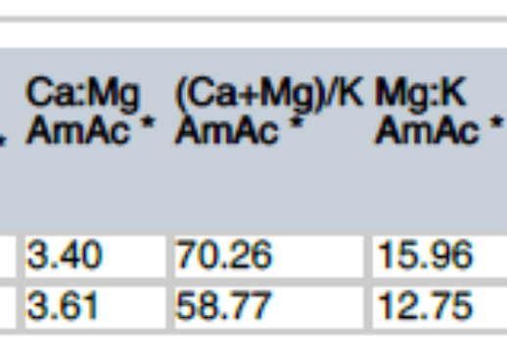
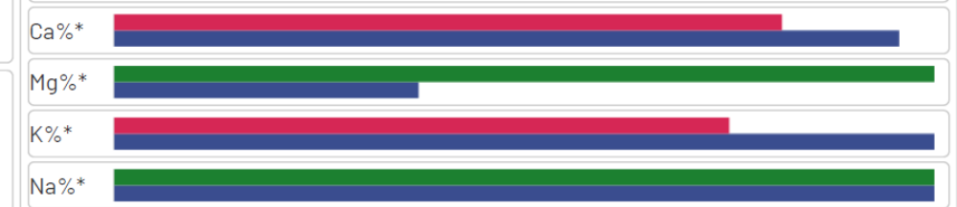
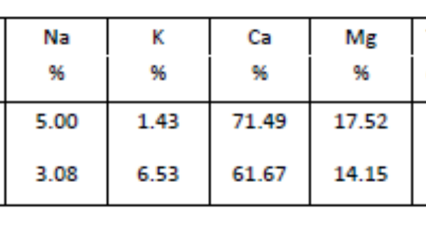
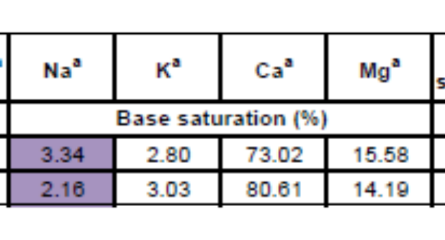
We should avoid basing recommendations on popular science
Notes:
So, I have to ask – why is it still reported meticulously by labs and used in recommendations?
I have to ask even myself, because Labserve also reports it, and I continue to take note of the Exchangeable sodium percentage when the soil is saline.
There are so many flaws in the BCSR system, that we have to stop using it.
It is unethical to use it to trump up K fertilization rates, or to justify Ca containing fertilisers on account of the so-called saturation rates.
I think I will leave it there, and start to close off by summarizing my thoughts.

Slide 58
Summary
Europe will continue to legislate in line with its objectives.
That is their prerogative.
It is our responsibility to respond in a way that asserts the interests of producers and protect them from losing existing market shares.
We should show a commitment to:
Uphold the vision of FERTASA
Respect the role that SACNASP is supposed to play, and if you are registered, honour the code of conduct.
Being subservient to science and reputable research to correct our thinking and direct our advice, to the benefit of our clients.

Slide 59


Science
Research
Sound Advice/Service
More Successful Farmers
Policy
More Successful …Selves
Notes:
Without a Light and Lens, ongoing investigation; and instructions, rules and procedures to maintain the lighthouse, the town and its people will not have a functioning lighthouse to save ships from crashing.
We need to collate science and research with the different policies that bear upon us; then we will provide sound advice and service.
INSTEAD OF LEADING FARMERS TO RISK THE ACCESS TO INTERNATIONAL MARKETS THROUGH IRRESPONSIBLE PRACTICES, we must lead them to be more successful farmers.
The more successful they are, the more successful ….we will be.

