Slide 1

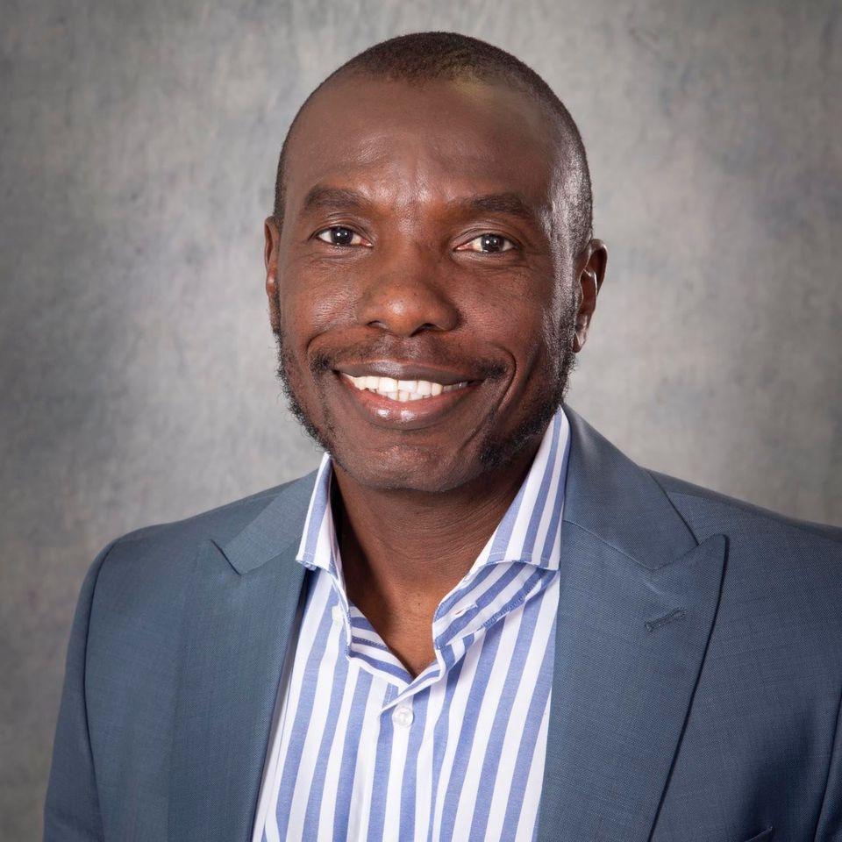

Dr Mmboneni Muofhe
Department of Science, TECHNOLOGY & iNNOVATION
Presentation Topic: AI and the Internet of Things

