Slide 1
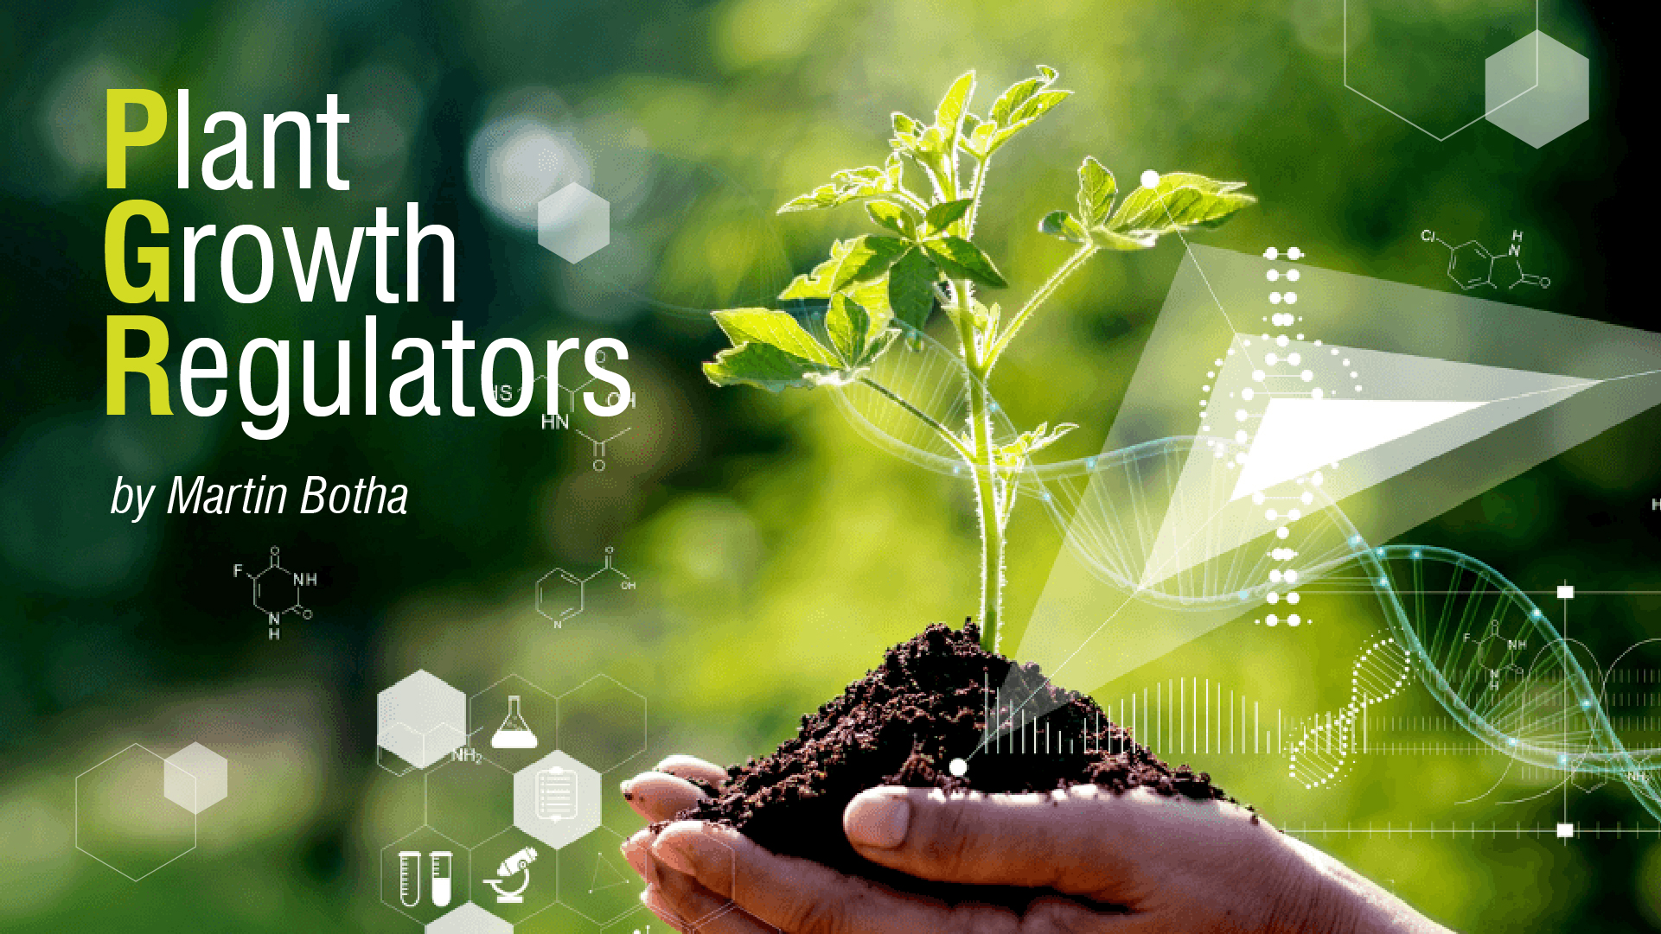

Slide 2

_{TIME FOR A NEW MINDSET}
_{THE PGR CONUNDRUM}
1
What is a PGR
2
PGR: Classification, Regulation & Chemonoia
3
PGRs Relationship with Biostimulants

Slide 3
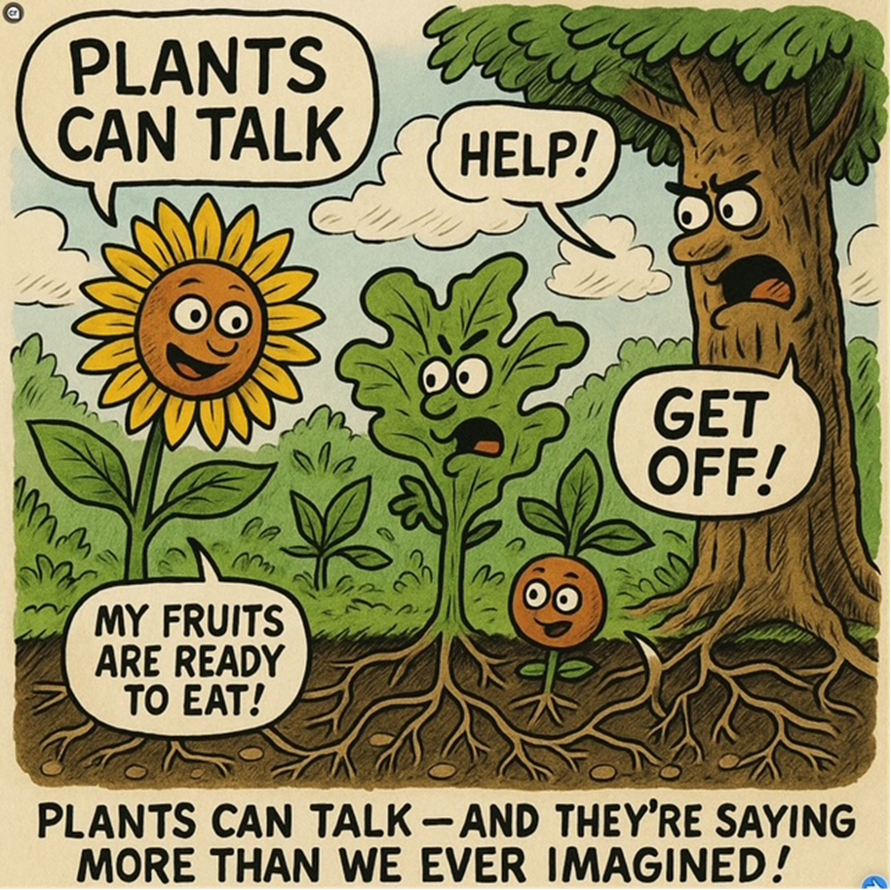
PLANTS TALK
HORMONES
ROS
PHENOLICS
VOC
STERIODS
LIPIDS
PEPTIDES
TERPENOIDS

Slide 4
WHAT IS A PGR?
Natural or synthetic compounds that influence plant physiological processes.
Function:
Modify growth patterns, plant development, and stress responses.
Key characteristic:
Active in very small amounts (hormone-like activity).

Slide 5
PGRs OVER THE YEARS
1800s Auxin activity was described by Darwin.
1926: Discovery of auxins by Frits Went (first plant hormone identified).
1930s – 1960s: Discovery of other PGRs like gibberellins, cytokinins, abscisic acid, and ethylene.
1970s – 1980s: Expansion of synthetic PGRs in agriculture (e.g., fruit thinning, growth control, etc).
1990s – 2000s: Regulatory concerns about synthetic PGR residues (Paclobutrazol); Insufficient residue data, analytical methods, harmonization.
2010s – 2020s: Shift toward sustainability: Biostimulants and natural PGRs gained attention.
  Precision agriculture: PGRs used in targeted applications.
  2020s: Emergence of “Bio-PGRs”—overlap with biostimulants.

Slide 6
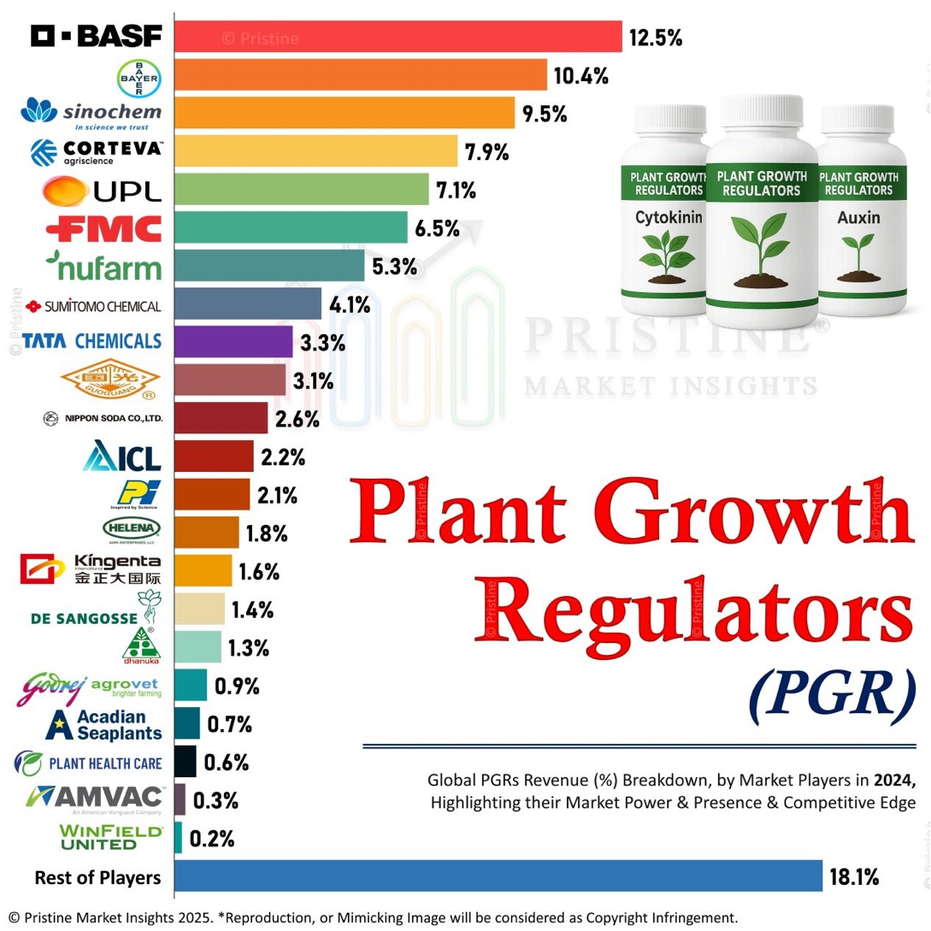
54%
Global sales:
> US$2.5 Billion

Slide 7
CHARACTERISTICS
Influences biotic growth factors:
Seed development, plant size, and branching of roots
& stems, flowering, fruit-firmness, -ripening & -quality
Acts against abiotic stress:
Drought, water & cold stress
Can be both Promoters & Inhibitors:
Promotes growth: Auxin, Cytokinin, Gibberellin
Inhibits growth: Abscisic acid
Promotes & Inhibits growth: Ethylene

Slide 8
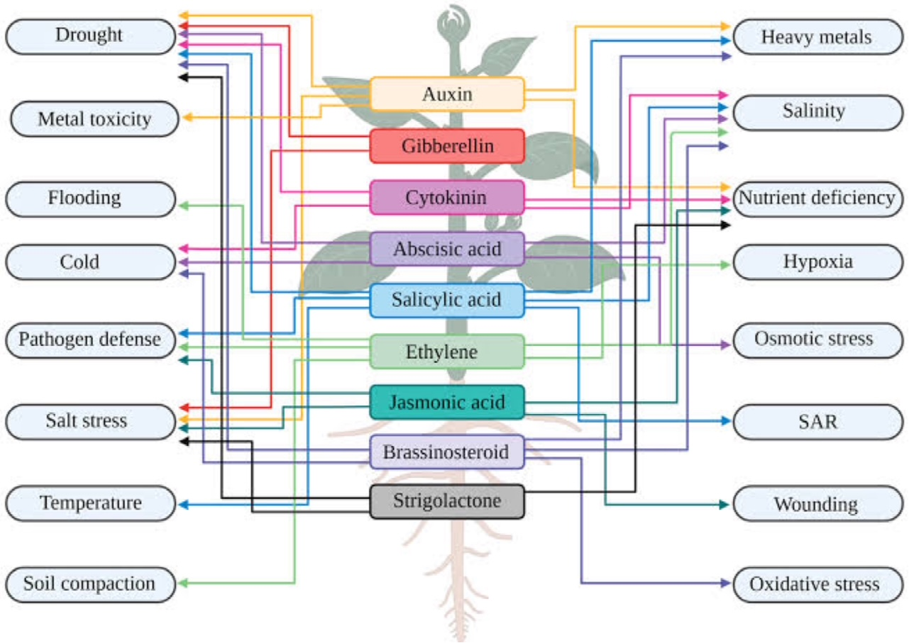
MULTI, SINGLE & COLLABORATIVE FUNCTIONALITY

Slide 9
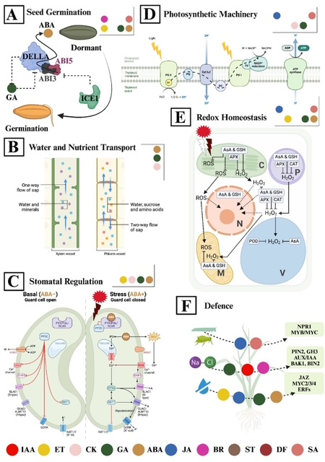
It's a crucial process for maintaining proper cellular function and preventing damage caused by reactive oxygen species (ROS)
STRATEGIC
AND
COMPLIMENTARY
ACTIONS

Slide 10
MAIN PGR TYPES
Type | Main Role | Natural or Synthetic
Auxins | Cell elongation, apical dominance | Both
Gibberellins | Stem elongation, seed germination | Both
Cytokinins | Cell division, shoot formation | Both
Abscisic Acid | Stress response, stomatal closure | Natural
Ethylene | Ripening, senescence, stress response | Natural
Brassinosteroids | Cell expansion, vascular differentiation | Natural
Synthetic PGRs | Various to stimulate various processes or inhibit growth (Paclobutrazol) or herbicidal (2,4-D) | Synthetic

Slide 11
PGR vs FERT. vs REMEDY: CLASSIFICATION
Category | Function | Pesticidal? | Nutritional? | Hormonal?
PGRs | Modify growth signals | Sometimes ✅ | ❌ | ✅
Fertilizers | Supply essential nutrients | ❌ | ✅ | ❌
Biostimulants | Stimulate metabolism or stress tolerance | ❌ | Often ❌ | Sometimes ✅
Remedies | Protect from pests/disease | ✅ | ❌ | Sometimes ✅

Slide 12
POLICIES & PERCEPTIONS
One-Size-Fits-All Policies:
We can't afford to be ruled by one-size-fits-all policies. We need policymakers who understand the nuances of our agricultural sector and the impact of their decisions on food security.
Chemonoia (Chemical Paranoia) Reality:
The intense fear of "chemicals", especially synthetic chemicals, is based on emotion more than information.
"We are primed to fear the artificial and prefer the natural. It is the reason we fear Wifi signals while we happily lay on the beach without sunblock"

Slide 13
Misunderstanding of “Plant Hormones” as Artificial or Dangerous
Many people conflate PGRs with harmful synthetic chemicals or even confuse them with animal hormones (like steroids).
Despite some PGRs being naturally occurring or mimicking natural plant hormones, chemonoia leads to fear by association — "chemical = synthetic = harmful."
🌿 For example: Gibberellic acid (GA₃) is a naturally occurring hormone, but in a bottle labelled as a “PGR,” it may still trigger suspicion among consumers.
Media and Marketing Misinformation
Sensational media and marketing often blur the line between agricultural inputs and health hazards, suggesting that hormones in agriculture lead to cancer, early puberty, or environmental damage — even when these claims are unrelated to plant hormones.
This reinforces a generalized fear of all chemicals in food production.

Slide 14
Regulatory Categorization Reinforces Fear
PGRs are classified under pesticide regulations, which makes the public assume they are toxic or dangerous, even when their toxicity is negligible.
This classification, necessary for legal purposes, reinforces the chemonoic narrative that PGRs are something to be avoided.
Cognitive Bias and Emotional Framing
Terms like “hormone-treated”, “chemically ripened”, or “growth modified” trigger emotional responses rooted in chemonoia, not science.
This is exacerbated by social media, where images or posts warning against “hormone-injected vegetables” go viral — even though plants naturally produce most of these hormones.

Slide 15
PGR RISK
CLASSIFICATION OF PGRs SHOULD BE BASED ON A REALISTIC VIEW OF THEIR APPLICATION & RISK
The real question is not whether we use chemicals. It’s how responsibly we use them.
Risk = Hazard X Exposure
Case-by-Case, not one size fits all
Based on science, not fiction or imagination
Based on evidence, not hearsay or guesswork

Slide 16
TOXICITY (GHS)
TYPE | HAZARD CLASS | PHYSICAL TOX | ENVIRONMENTAL TOX
AUXIN (I3AA / I3BA) | Acute Tox: H302 Skin Irr: H315 Eye Irr: H319 | No significant hazard | No significant hazard
CYTOKININ (KINETIN) | None |  | No significant hazard
EHYLENE | Flammable: H220 |  | No significant hazard
GIBB. | Eye Irr: H319 |  | Aquatic: H412
ABA | None |  | Aquatic: H412
HARMFUL IF SWALLOWED
"Almost all PGRs have negligible GHS toxicity profiles."

Slide 17
TOXICITY (ACTUAL)
TYPE | NORMAL APPLICATION RATE | PHYTO TOXICITY | ANIMAL TOXICITY | REGULATORY CONCERN
I3AA I3BA NAA | 0.01μM - 10μM 0.1μM - 50μM 0.01μM - 5μM | > 100μM (≈18 mg/L) > 100μM (≈25 mg/L) > 25μM (≈6 mg/L) | No observed severe effects. Practically non-toxic under normal exposure levels used in agriculture | Not regulated as toxic
KINETIN | 1μM - 10μM | > 50μM (≈10 mg/L) |  | No regulatory concern
EHYLENE | 0.01 – 0.1 ppm | 1 – 10 ppm |  | Asphyxiant (> 5%)
GIBB. | 1μM - 10μM | > 30μM (≈9 mg/L) |  | Not regulated as toxic
ABA | 0.01μM - 10μM | > 50μM (≈13 mg/L) |  | No regulatory concern
"Auxin: 11 mg/L @ 2L/ha ≈ 6 mg/ha (< 1μM)"

Slide 18
TOXICITY
All listed plant hormones have:
- low toxicity risk for plants at typical exposure levels.
- low toxicity in animals at typical exposure levels.
Ethylene poses a physical hazard (oxygen displacement), not chemical toxicity, but it is highly flammable.
None are mutagenic, carcinogenic, or teratogenic at tested concentrations.
"Risk = Hazard X Exposure"

Slide 19
RELATIONSHIP BETWEEN PGRs & BIOSTIMULANTS
Overlap:
  Many biostimulants contain natural compounds with hormonal activity (e.g., seaweed extracts → "auxin-like").
Distinction:
  PGRs are regulated for their direct hormonal effect.
  Biostimulants work indirectly, or through stimulation of metabolic activity, sometimes "mimicking" hormones.

Slide 20
Can PGRs Act as Biostimulants?
✅ Yes, when used at low doses or in natural form, PGRs can enhance growth indirectly:
Example: Seaweed extract containing auxins and cytokinins promotes root growth → considered a biostimulant.
Can Biostimulants Act as PGRs?
✅ Sometimes, especially if:
They trigger hormonal pathways (e.g., stress tolerance via abscisic acid-like response).
They contain or stimulate the production of endogenous PGRs in plants.

Slide 21
Are PGRs Dose-Dependent?
✅ Highly dose-dependent:
Low concentrations stimulate growth.
High concentrations can inhibit growth or cause toxicity.
Example: Auxin overdose → inhibits root elongation rather than promoting it.
RISK
CASE-BY-CASE
BASED ON SCIENCE
BASED ON EVIDENCE
If the Dose is Low Enough, Are PGRs Then Biostimulants?
🟡 In practical terms, yes—but legally, no.
Functionally, low-dose PGRs may act like biostimulants.
But regulatory frameworks distinguish them:
  Biostimulants are not regulated as pesticides or PGRs.
  Intent, mode of action, and dose determine classification.

Slide 22
THE FUNDEMENTALS
Mode of action?
PGR (Specific) modify plant physiological processes → direct
PB (General) stimulate natural processes → indirect or synergistic
Composition?
PGR Synthetic, mixture, or purified natural
PB complex natural mixtures
Function?
PGR direct hormonal manipulation
PB indirect or synergistic physiological support

Slide 23
REGULATORY CLASSIFICATION?
PGR Pesticide ☺ → "Potent" hormone-like activity
PB Fertilizer ☺ → Do not exert hormonal control
While PGRs and PB can both enhance plant growth and nutrient use efficiency, they are fundamentally different in how they're classified and how they're regulated.
"The smarter we are, the better we are at twisting facts."

Slide 24
FUNCTION RATHER THAN FORMULATION
The concept of plant health is evolving beyond the mere absence of disease or nutrient deficiency. In the context of unstable climates and complex production systems, it is increasingly understood as the dynamic ability to maintain balance, respond to stress, and recover function. Biostimulants are viewed as tools that support adaptability rather than stimulate growth.
…… biostimulants do not supply essential nutrients but deliver bioactive signals that modulate physiological pathways and enhance resilience. Their value lies in reinforcing internal regulatory mechanisms rather than increasing external inputs. This reflects a broader shift in agronomy, from resource supplementation to managing physiological stability under variable conditions.
(Du Jardin et al., 2025)

Slide 25
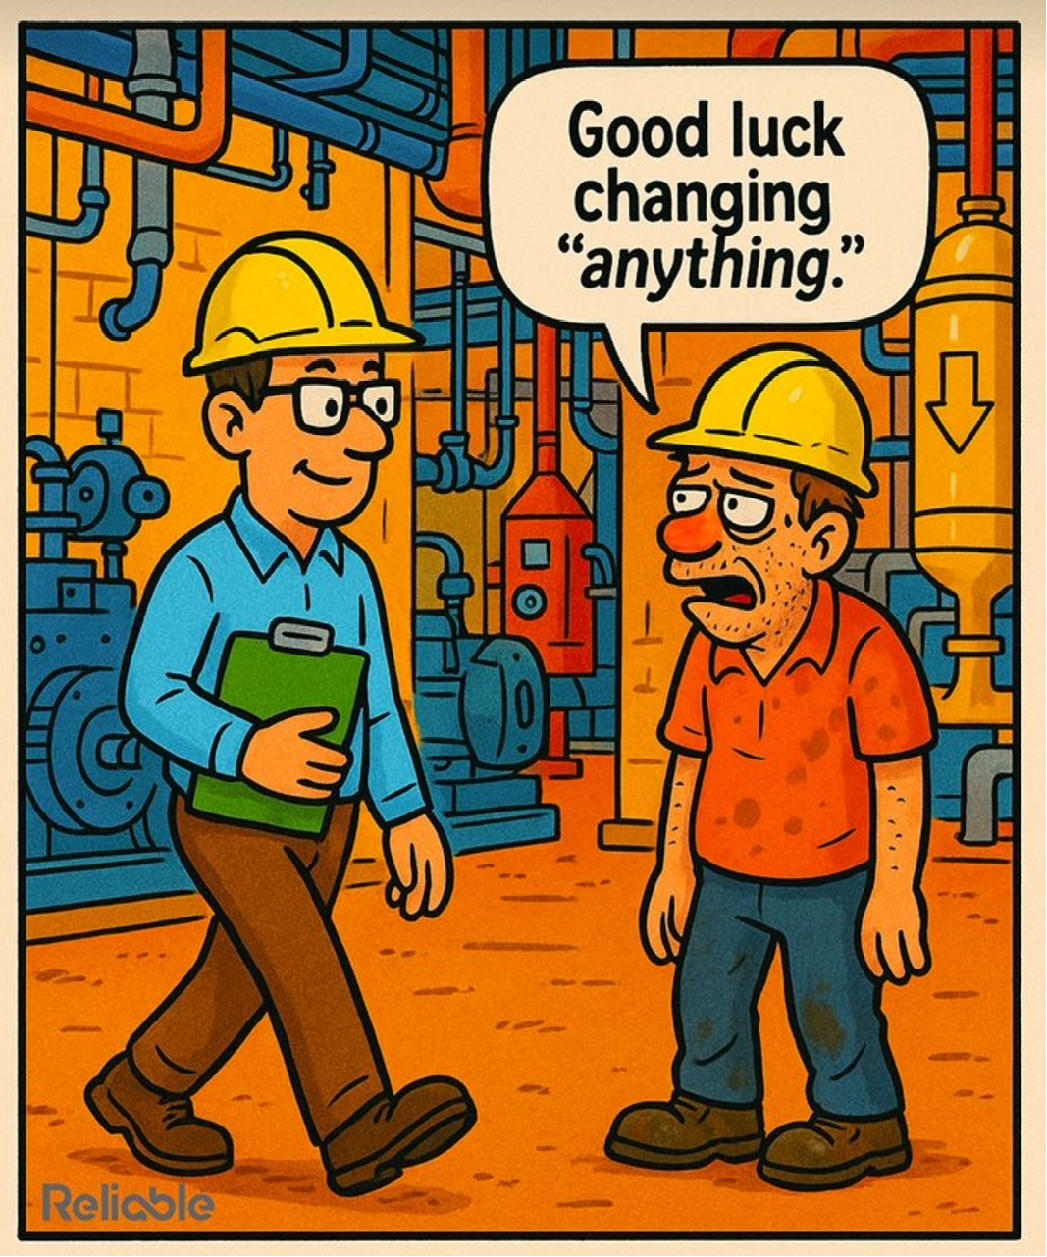
T
H
A
N
K
Y
O
U

